Slide 1

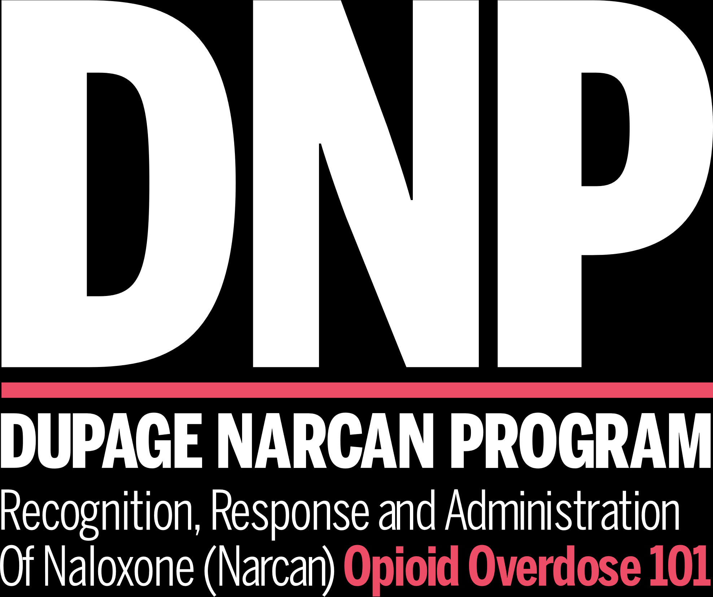

Slide 2

IMPORTANCE OF PREVENTION
In 2020, 75% of drug overdose deaths involved an opioid
An average of 188 people die each day from overdoses involving opioids in the United States
56,000 deaths from synthetic opioids, including fentanyl and fentanyl analogs, in 2020.
Deaths from synthetic opioids in 2020 was more than 18 times the number in 2013.
Abstinence, or non-use, from opiate drug abuse is the most effective overdose prevention option
(Source: Centers for Disease Control and Prevention)

Slide 3
IMPORTANCE OF PREVENTION
High number of deaths attributed to opioid overdoses in DuPage County called a public health epidemic in 2013
Opioid overdose deaths (DuPage County Coroner):
2013 – 48
2014 – 33
2015 – 54
2016 – 95
2017 – 95
2018 – 98
2019 – 96
2020 – 112
2021 – 102
2022 - 121
Abstinence, or non-use, from opiate drug abuse is the most effective overdose prevention option

Slide 4
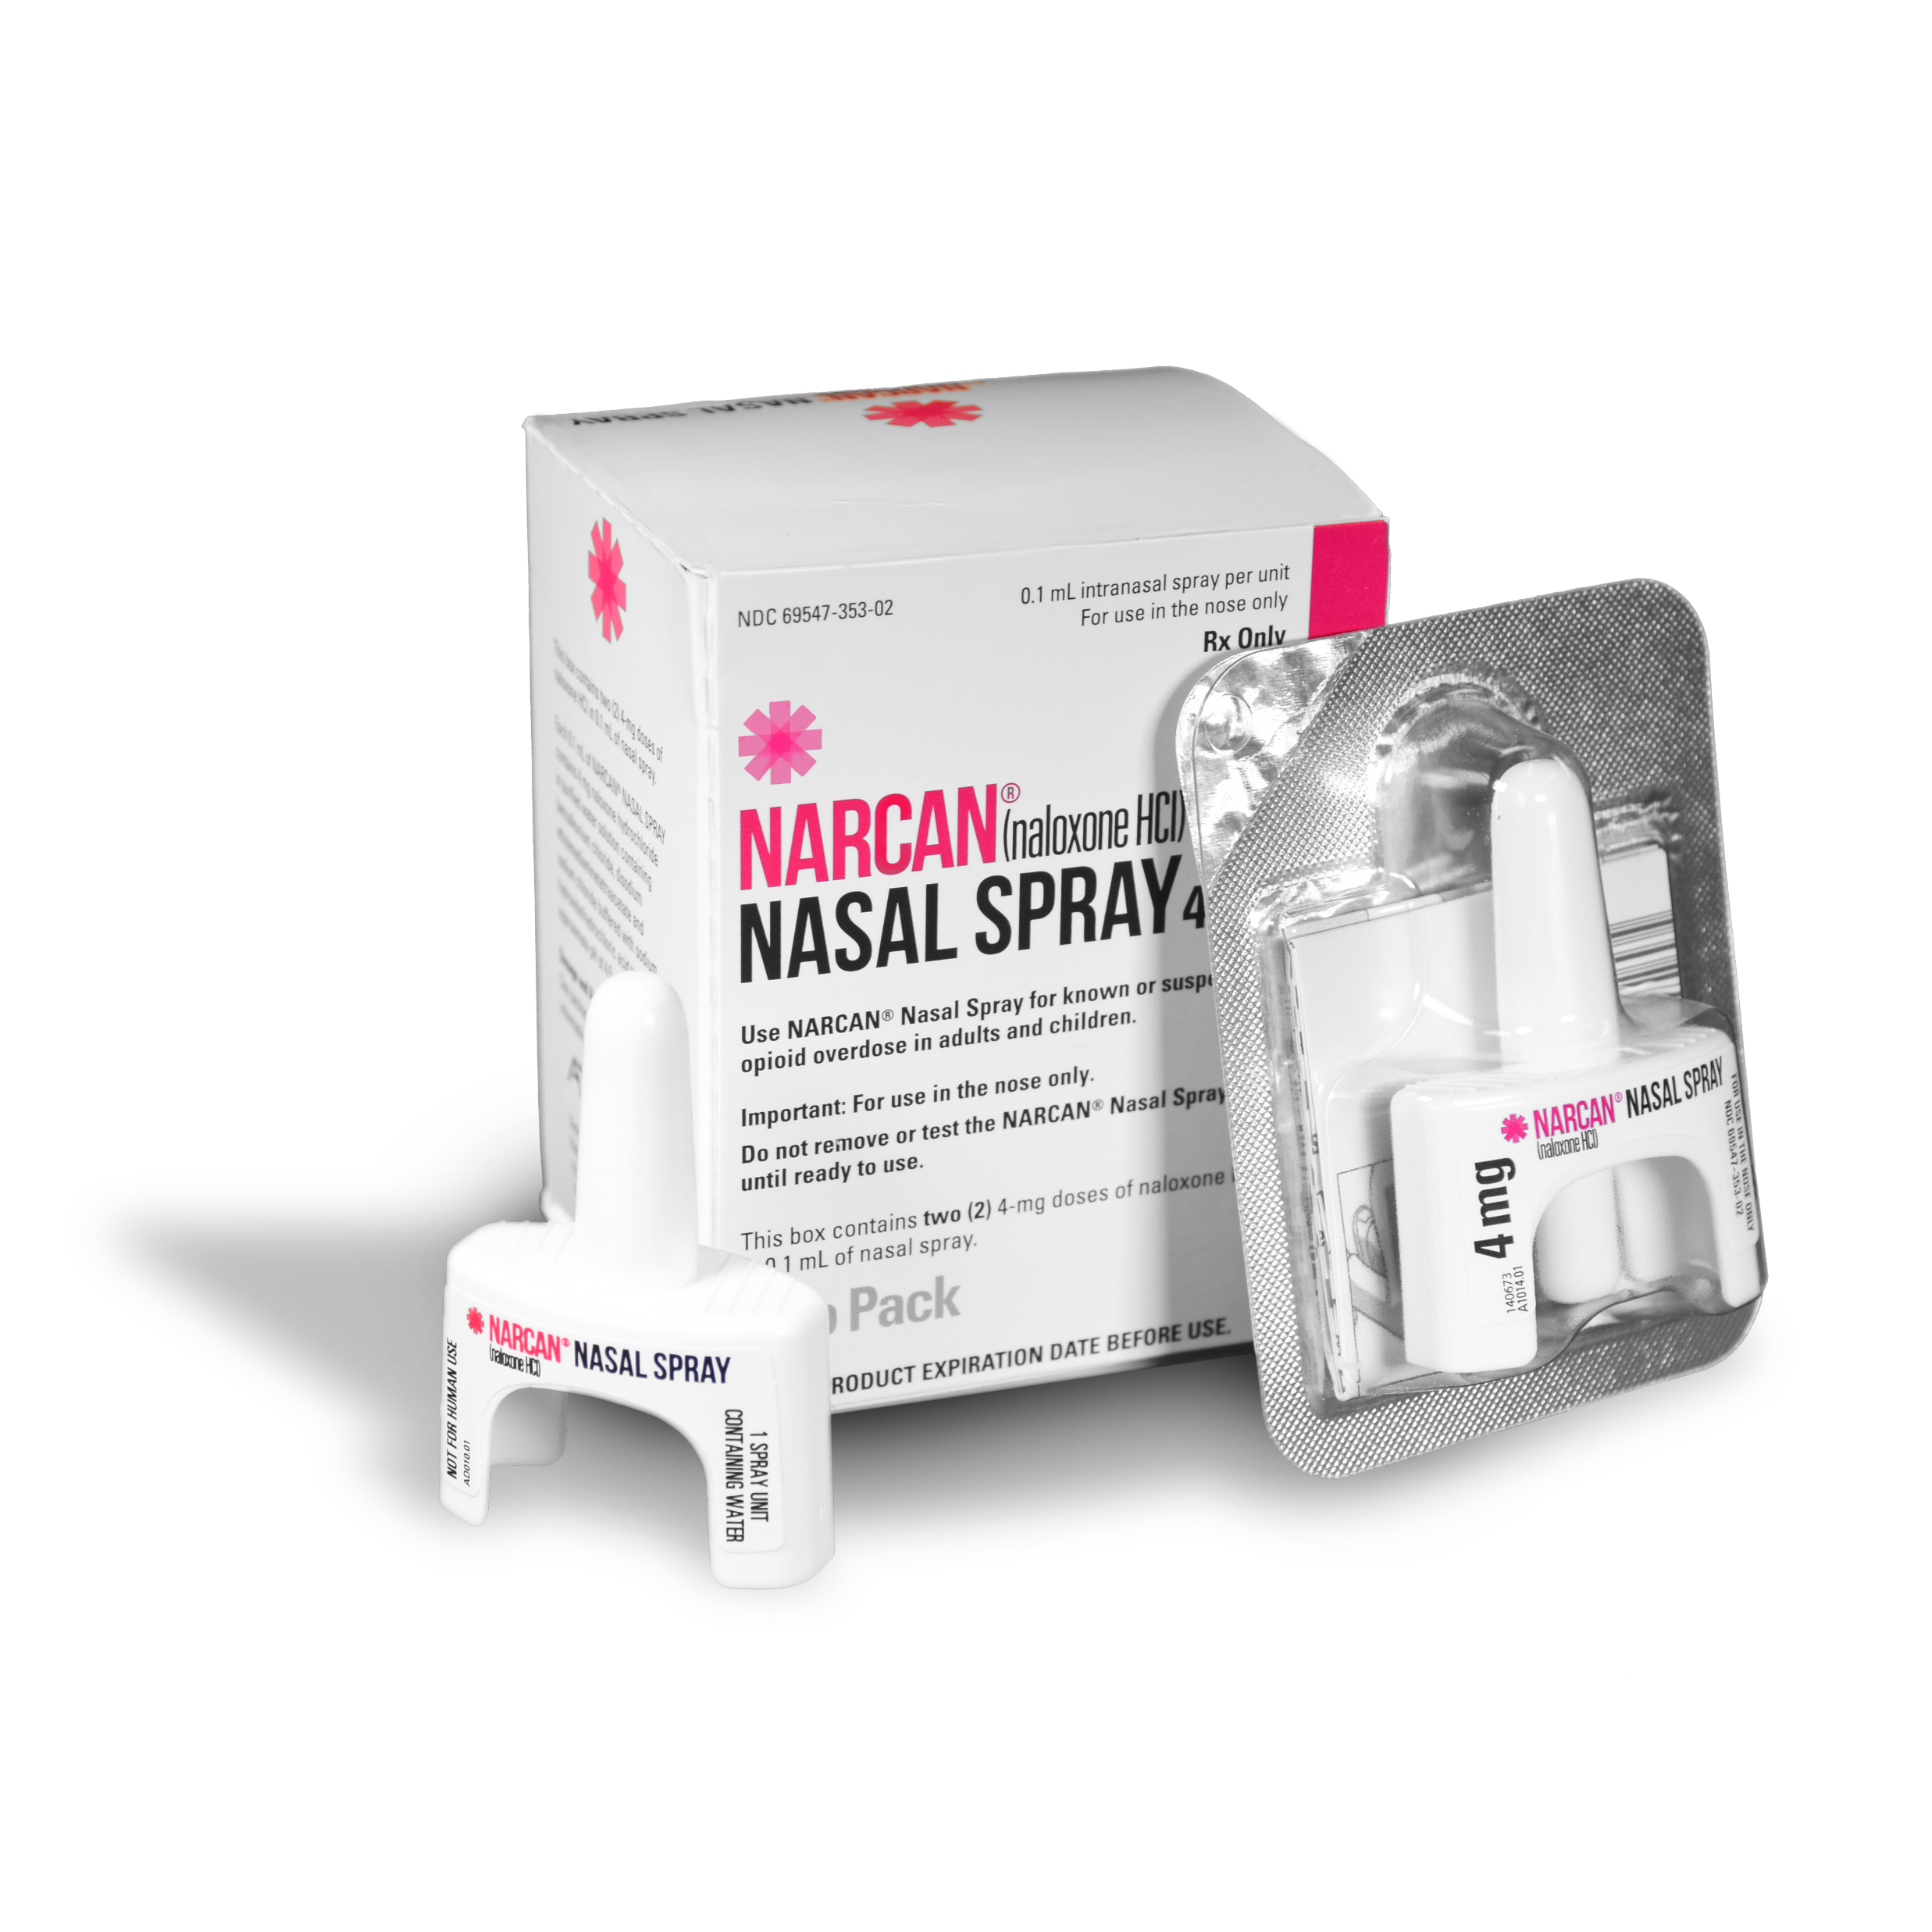
IMPORTANCE OF PREVENTION
Abstinence, or non-use, from opiate drug abuse is the most effective overdose prevention option
Naloxone:
Is a drug used to reverse the effects of opioids
Is safe and effective
Has no effect on non-opioid overdoses

Slide 5
IMPORTANCE OF PREVENTION
About the solution – why focus on opioid overdose?
Overdose deaths can be prevented by both first responders and bystanders
Most people with substance use disorders try to achieve abstinence, but the path to recovery is different for everyone
Lives can be saved!
Abstinence, or non-use, from opiate drug abuse is the most effective overdose prevention option

Slide 6
LEGAL CONSIDERATIONS
Illinois Public Act 096-0361 passed/effective January 1, 2010
Provides amendment to the Alcoholism and Other Drug Abuse and Dependency Act to allow Naloxone administration by persons not considered “health care professionals” in an emergency.
“A person who is not otherwise licensed to administer an opioid antidote may in an emergency administer… and believes in good faith that another person is experiencing a drug overdose.”
“The person shall not, as a result of his or her acts or omissions, be liable for any violation of [professional practice acts] or any other professional licensing statute, or subject to any criminal prosecution arising from or related to the unauthorized practice of medicine or the possession of an opioid antidote.”
Abstinence, or non-use, from opiate drug abuse is the most effective overdose prevention option

Slide 7
LEGAL CONSIDERATIONS
In summary, the law supports:
Naloxone administration as a standard tool
Use in an emergency/overdose scenario
Training for all persons (non-health care professionals) to use
Elimination of fear of liability or punishment in the event of use
First responding personnel are encouraged to consult their agency’s legal representative with questions regarding Public Act 096-0361 http://www.ilga.gov/legislation/publicacts/fulltext.asp?Name=096-0361
as well as the (745 ILCS 49/) Good Samaritan Act. http://www.ilga.gov/legislation/ilcs/ilcs3.asp?ActID=2076&ChapterID=58
Abstinence, or non-use, from opiate drug abuse is the most effective overdose prevention option

Slide 8
OPIOID BASICS
How Naloxone works:
Temporarily blocks the effects of opioids, giving the person the chance to breathe.
Naloxone works in 1 to 3 minutes, keep this mind when giving multiple doses.
Naloxone will work to for 30 to 90 minutes to reverse the overdose.
Naloxone can neither be abused nor cause overdose, only contraindication is known sensitivity, which is rare.
Abstinence, or non-use, from opiate drug abuse is the most effective overdose prevention option

Slide 9
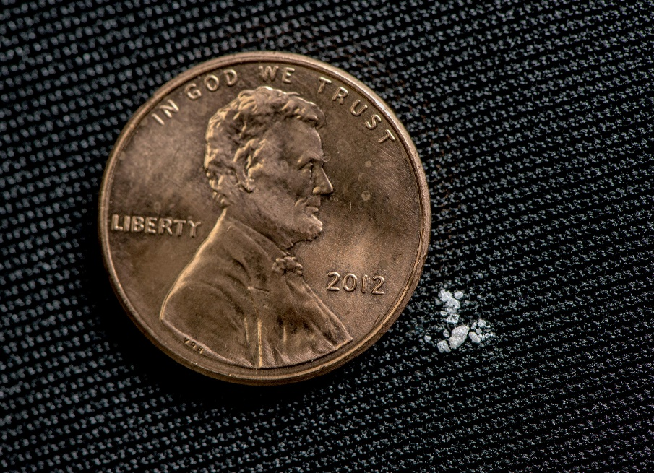
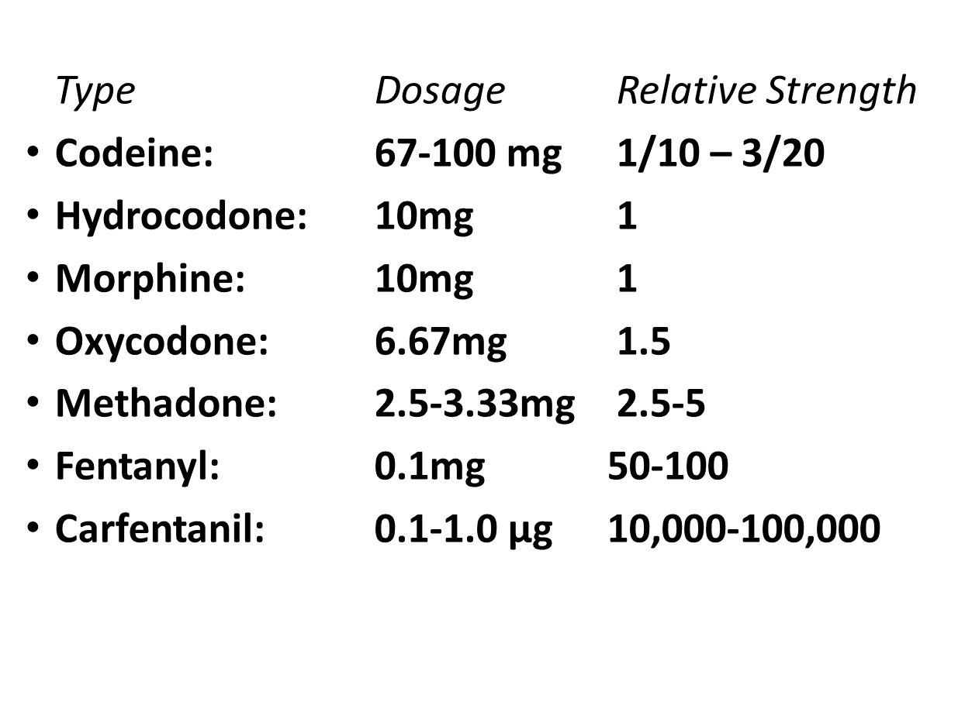
OPIOID BASICS
Strength of Rx Opioids from
Lowest to Highest
Abstinence, or non-use, from opiate drug abuse is the most effective overdose prevention option
2 mg of fentanyl
Source: U.S Drug Enforcement Administration

Slide 10
OPIOID BASICS
How to identify an opioid overdose
Abstinence, or non-use, from opiate drug abuse is the most effective overdose prevention option
REALLY HIGH | OVERDOSE
Muscles become relaxed | Deep snoring or gurgling (death rattle)
Speech is slowed/slurred | Very infrequent or no breathing
Sleepy looking | Pale, clammy skin
Nodding | Heavy nod
Will respond to stimulation like yelling, sternal rub, pinching, etc. | No response to stimulation
 | Slow heart beat/pulse

Slide 11
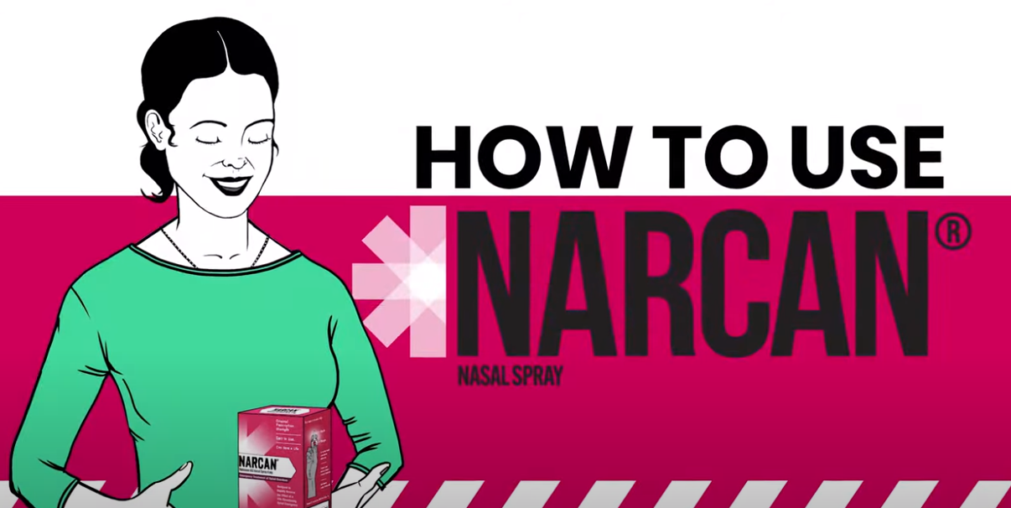
NALOXONE INTERVENTION
Respond to an opioid overdose
Overview Video (click picture or URL to view video)
Abstinence, or non-use, from opiate drug abuse is the most effective overdose prevention option
https://www.youtube.com/watch?v=B9Sv64FJPhg

Slide 12
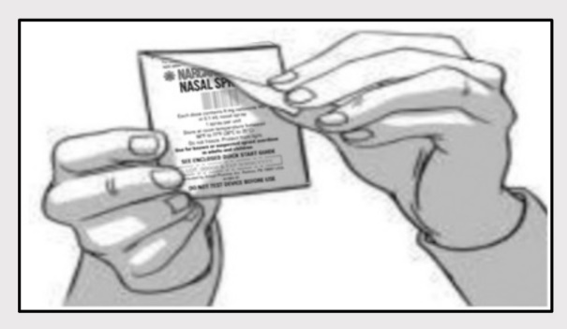
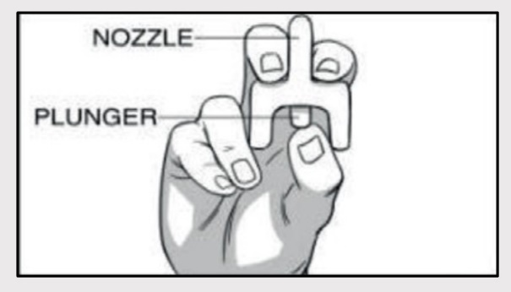
NALOXONE INTERVENTION
How to give nasal spray Narcan
Abstinence, or non-use, from opiate drug abuse is the most effective overdose prevention option
Step 1
Remove NARCAN Nasal Spray from the box. Peel back the tab with the circle to open the NARCAN Nasal Spray.
Step 2
Hold the NARCAN nasal spray with your thumb on the bottom of the plunger and your first and middle fingers on either side of the nozzle.

Slide 13
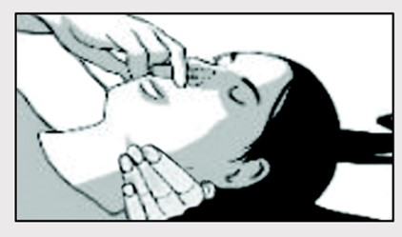
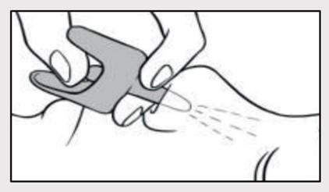
NALOXONE INTERVENTION
How to give nasal spray Narcan
Step 3
Tilt the person’s head back and provide support under the neck with your hand. Gently insert the tip of the nozzle into one nostril, until your fingers on either side of the nozzle are against the bottom of the person’s nose.
Abstinence, or non-use, from opiate drug abuse is the most effective overdose prevention option
Step 4
Press the plunger firmly to give the dose of NARCAN Nasal Spray. Remove the NARCAN Nasal Spray from the nostril after giving the dose.

Slide 14
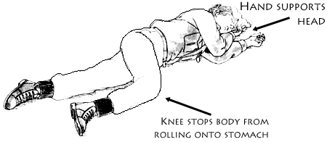
NALOXONE INTERVENTION
How to give nasal spray Narcan
Abstinence, or non-use, from opiate drug abuse is the most effective overdose prevention option
Recovery Position:
After Naloxone administration, place a recovering individual in the position shown here

Slide 15
RELEVANT PROCEDURES
Time to Practice!
Abstinence, or non-use, from opiate drug abuse is the most effective overdose prevention option
Hands-on Naloxone Demo – All participants should practice the naloxone administration steps as outlined in the previous slides.
Training instructor should inform all trainees of how to access reporting form and other materials

Slide 16
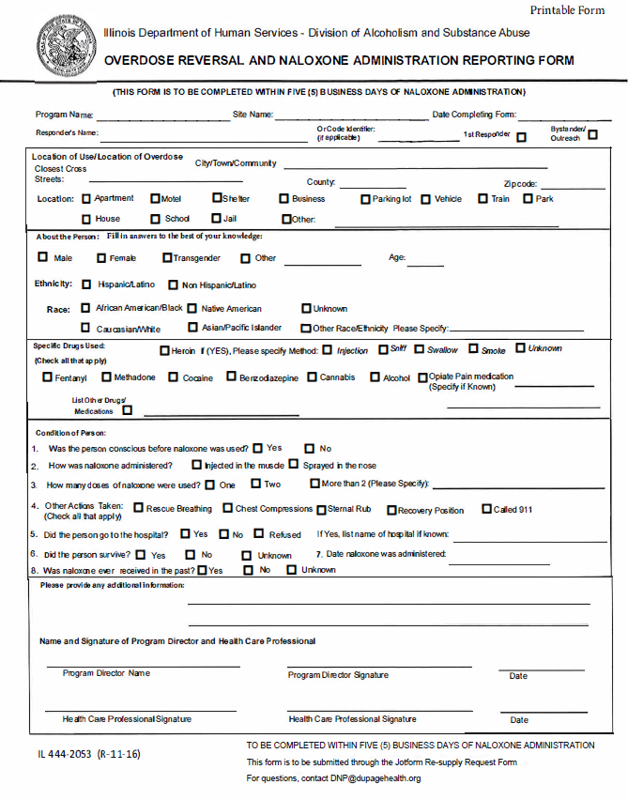
RELEVANT PROCEDURES
Documentation:
Naloxone Administration Reporting Form
This form is to be completed within FIVE business days of the naloxone administration
Questions?
Email DNP@DuPageHealth.org
Abstinence, or non-use, from opiate drug abuse is the most effective overdose prevention option

Slide 17
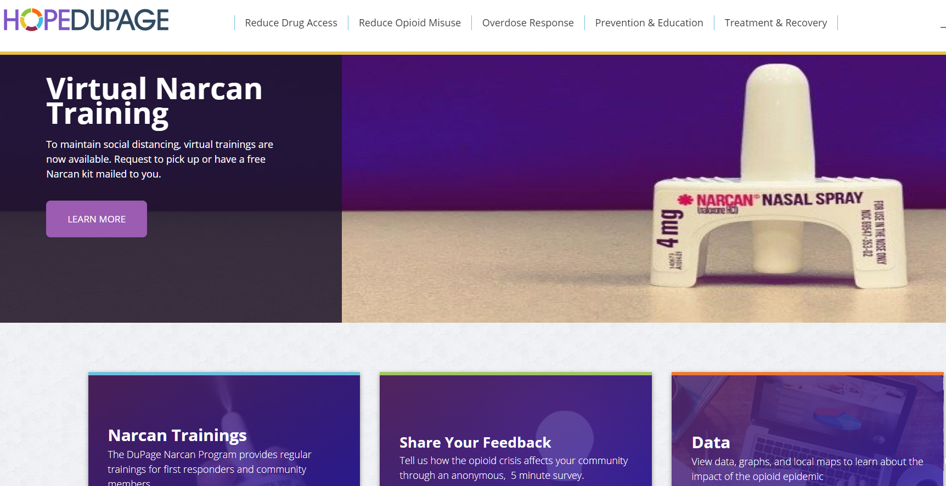
ADDITIONAL RESOURCES
HOPEdupage.org
Abstinence, or non-use, from opiate drug abuse is the most effective overdose prevention option

Slide 18
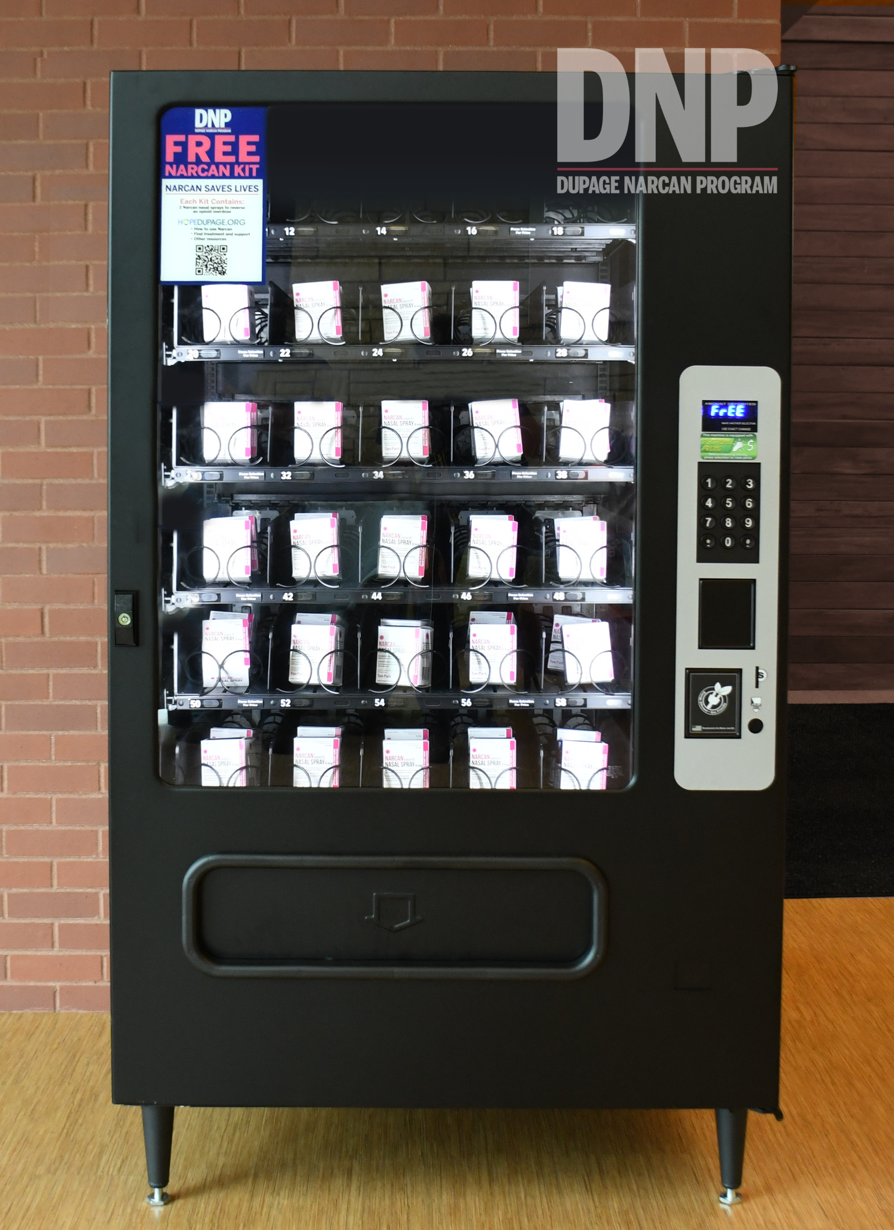
RELEVANT PROCEDURES
Abstinence, or non-use, from opiate drug abuse is the most effective overdose prevention option
Free Narcan vending machine available
Linda A. Kurzawa Community Center (115 N County Farm Rd, Wheaton, IL 60187)
Open 8:00am to 8:00pm, Mon-Fri

Slide 19
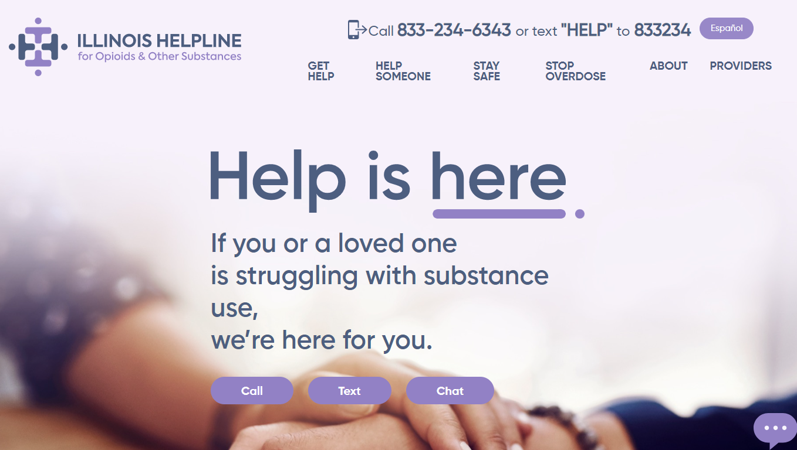
ADDITIONAL RESOURCES
Illinois Helpline for Opioids and Other Substances
1-833-2FINDHELP (or 833-234-6343) and helplineIL.org
Abstinence, or non-use, from opiate drug abuse is the most effective overdose prevention option

Slide 20

ANY QUESTIONS?
DNP@dupagehealth.org

