Slide 1

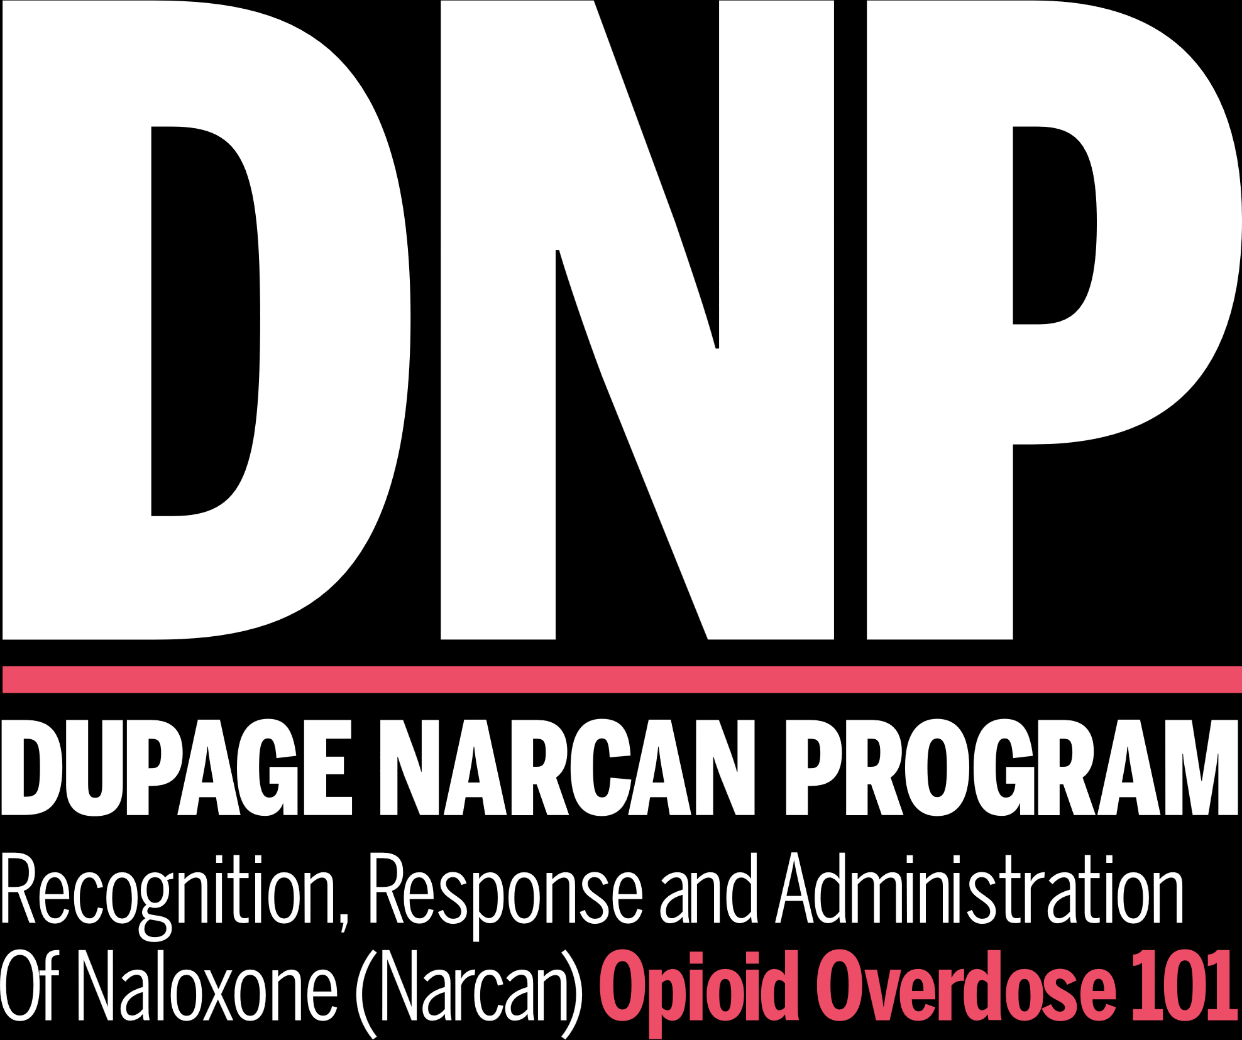
Library Narcan Training

Slide 2

BACKGROUND & GENERAL INFO

Slide 3

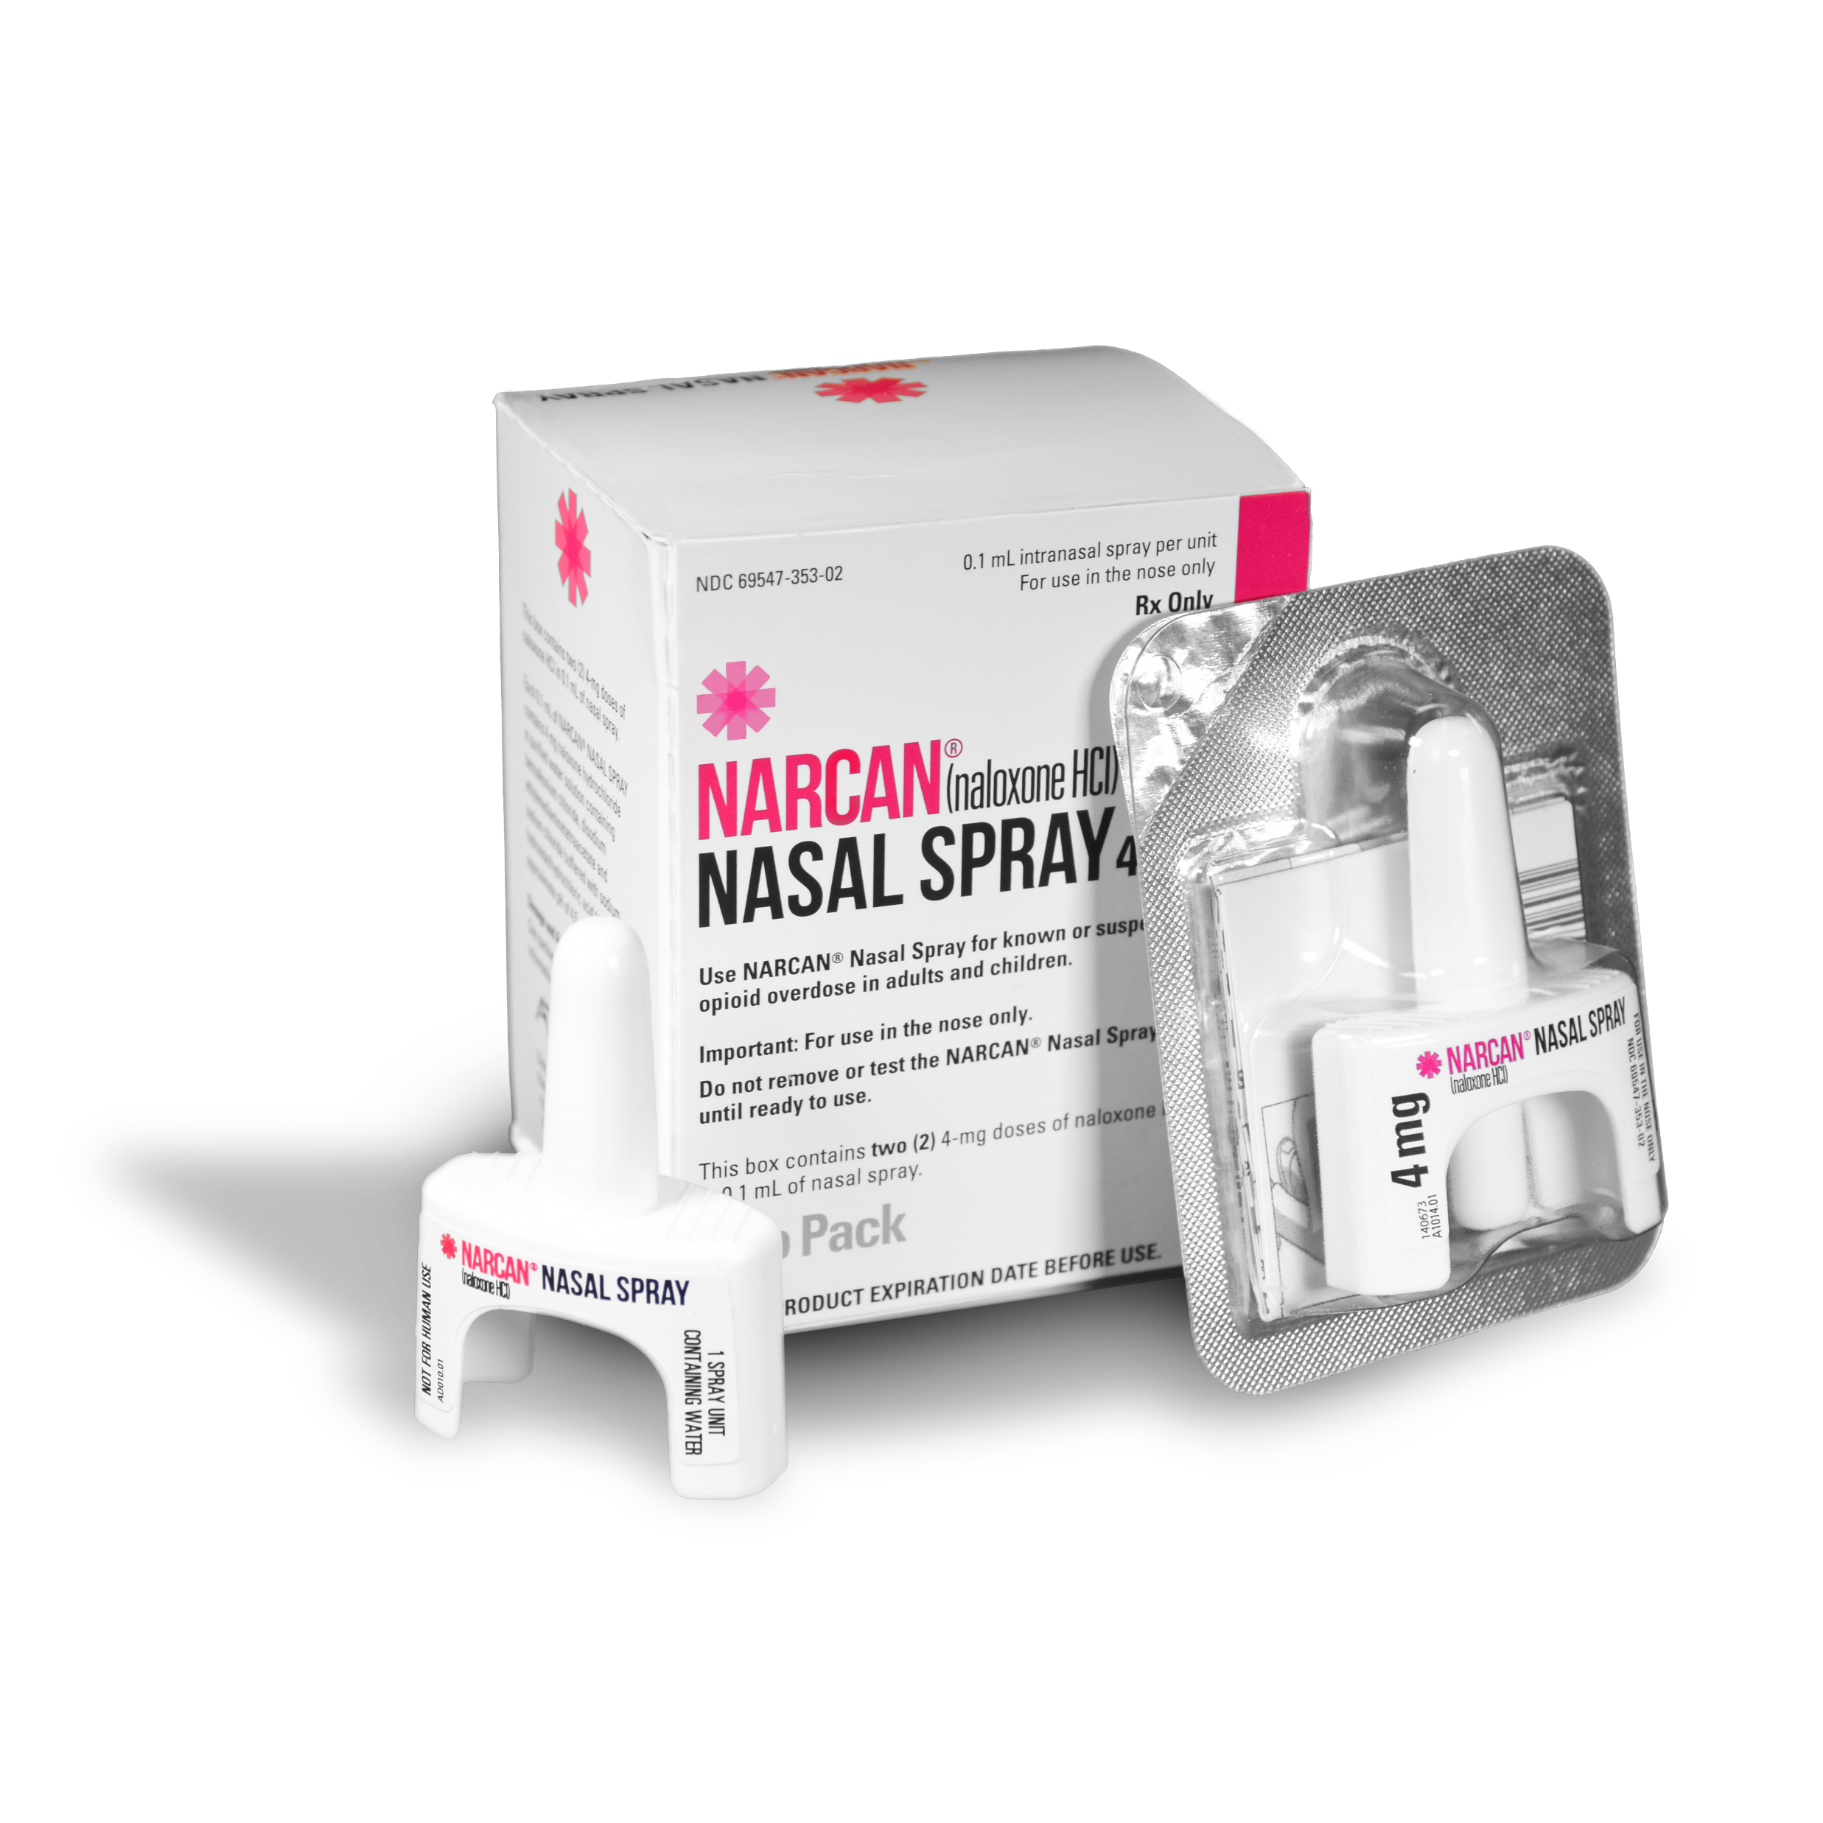
IMPORTANCE OF PREVENTION
Abstinence, or non-use, from opiate drug abuse is the most effective overdose prevention option
Most people with substance use disorders try to achieve abstinence, but the path to recovery is different for everyone
Naloxone:
Drug used to reverse overdose involving any opioid
Safe and effective
No effect on non-opioid overdoses

Slide 4
LEGAL CONSIDERATIONS
Illinois Public Act 096-0361 passed/effective January 1, 2010
Provides amendment to the Alcoholism and Other Drug Abuse and Dependency Act to allow Naloxone administration by persons not considered “health care professionals” in an emergency.
“A person who is not otherwise licensed to administer an opioid antidote may in an emergency administer… and believes in good faith that another person is experiencing a drug overdose.”
“The person shall not, as a result of his or her acts or omissions, be liable for any violation of [professional practice acts] or any other professional licensing statute, or subject to any criminal prosecution arising from or related to the unauthorized practice of medicine or the possession of an opioid antidote.”
Abstinence, or non-use, from opiate drug abuse is the most effective overdose prevention option

Slide 5
LEGAL CONSIDERATIONS
In summary, the law supports:
Naloxone administration as a standard tool
Use in an emergency/overdose scenario
Training for all persons (non-health care professionals) to use
Elimination of fear of liability or punishment in the event of use
First responding personnel are encouraged to consult their agency’s legal representative with questions regarding Public Act 096-0361 http://www.ilga.gov/legislation/publicacts/fulltext.asp?Name=096-0361
as well as the (745 ILCS 49/) Good Samaritan Act. http://www.ilga.gov/legislation/ilcs/ilcs3.asp?ActID=2076&ChapterID=58
Abstinence, or non-use, from opiate drug abuse is the most effective overdose prevention option

Slide 6
OPIOID BASICS
How Naloxone works:
Temporarily blocks the effects of opioids, giving the person the chance to breathe
Naloxone works in 1 to 3 minutes, keep this mind when giving multiple doses
Naloxone will work for 30 to 90 minutes to reverse the overdose
Naloxone can neither be abused nor cause overdose
There is potential for a rare allergic reaction to naloxone, further emphasizing the need to call 911
Abstinence, or non-use, from opiate drug abuse is the most effective overdose prevention option

Slide 7

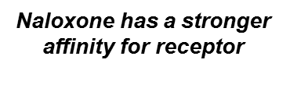
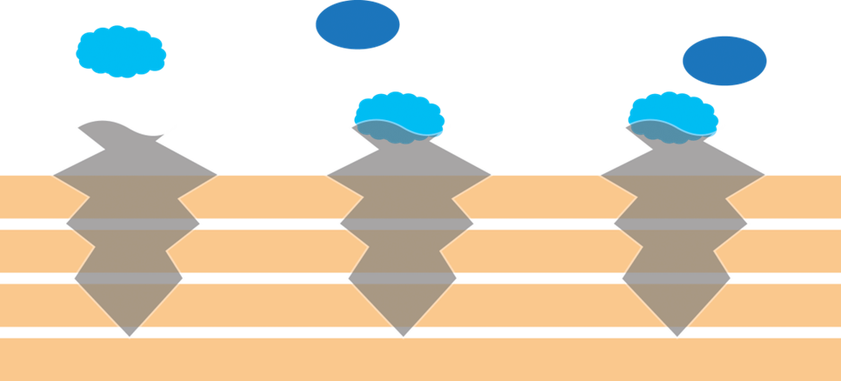
OPIOID BASICS
Naloxone Reversing an Overdose
Abstinence, or non-use, from opiate drug abuse is the most effective overdose prevention option

Slide 8
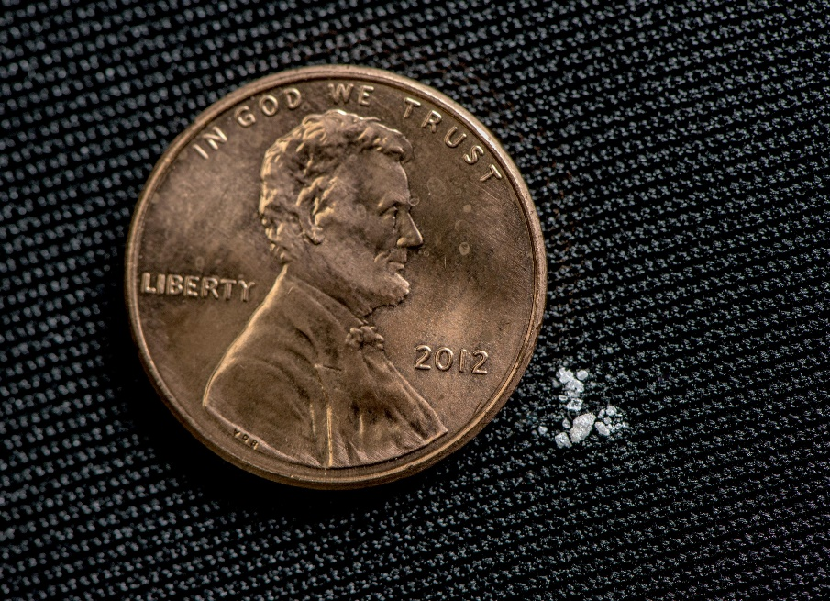
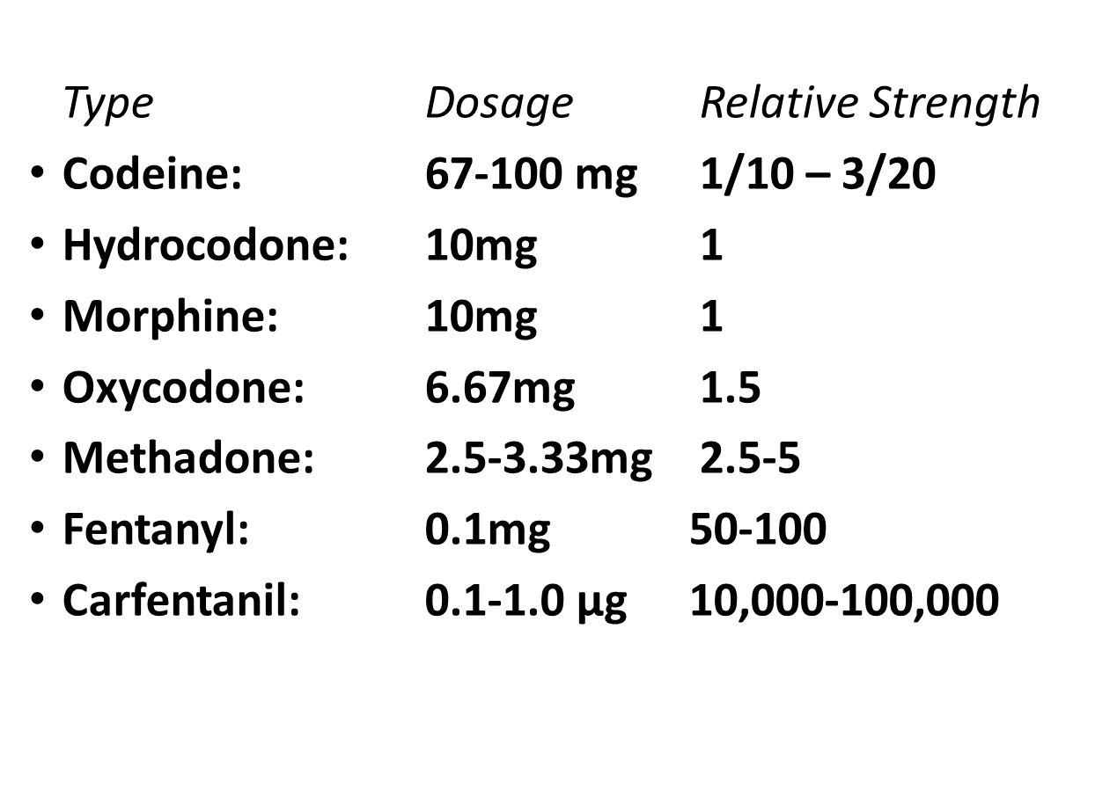
OPIOID BASICS
Strength of Rx Opioids from
Lowest to Highest
Abstinence, or non-use, from opiate drug abuse is the most effective overdose prevention option
2 mg of fentanyl
Source: U.S Drug Enforcement Administration

Slide 9
ADMINSTERING NARCAN

Slide 10
OPIOID BASICS
How to identify an opioid overdose
Abstinence, or non-use, from opiate drug abuse is the most effective overdose prevention option
REALLY HIGH | OVERDOSE
Muscles become relaxed | Deep snoring or gurgling (death rattle)
Speech is slowed/slurred | Very infrequent or no breathing
Sleepy looking | Pale, clammy skin
Nodding | Heavy nod
Will respond to stimulation like yelling, sternal rub, pinching, etc. | No response to stimulation
 | Slow heart beat/pulse

Slide 11
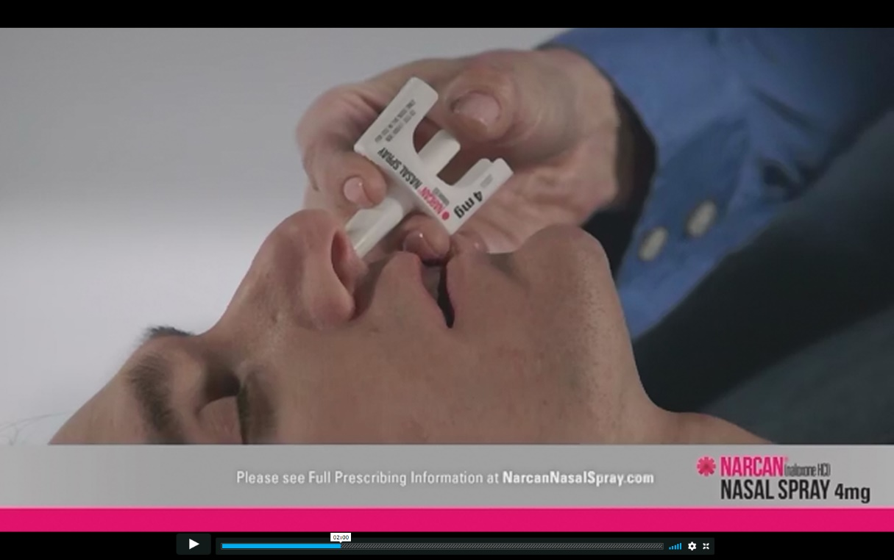
NALOXONE INTERVENTION
Respond to an opioid overdose
Overview Video (click picture or URL to view video)
Abstinence, or non-use, from opiate drug abuse is the most effective overdose prevention option
https://www.youtube.com/watch?v=WkWXX5DPmpg

Slide 12
NALOXONE INTERVENTION
Before giving Narcan, call 911
Either instruct someone else to call or dial 911 and place on speaker as you grab the Narcan
Emergency medical services will be necessary in either outcome
Operator can help you over the phone
Abstinence, or non-use, from opiate drug abuse is the most effective overdose prevention option

Slide 13
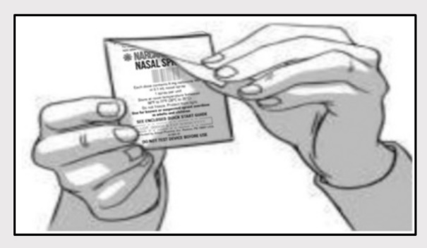
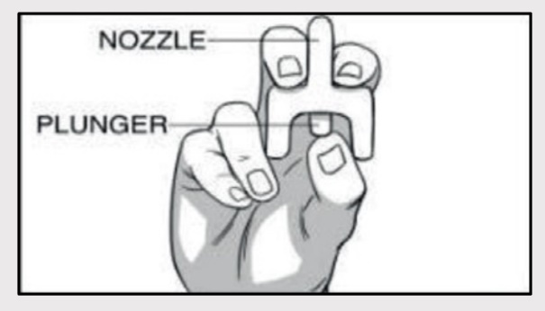
NALOXONE INTERVENTION
How to give nasal spray Narcan
Abstinence, or non-use, from opiate drug abuse is the most effective overdose prevention option
Step 1
Remove NARCAN Nasal Spray from the box. Peel back the tab with the circle to open the NARCAN Nasal Spray.
Step 2
Hold the NARCAN nasal spray with your thumb on the bottom of the plunger and your first and middle fingers on either side of the nozzle.

Slide 14
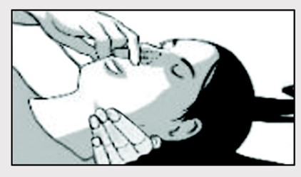
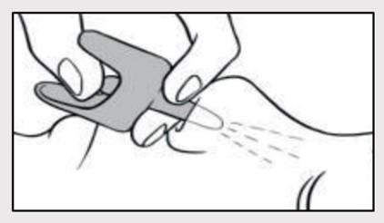
NALOXONE INTERVENTION
How to give nasal spray Narcan
Step 3
Tilt the person’s head back and provide support under the neck with your hand. Gently insert the tip of the nozzle into one nostril, until your fingers on either side of the nozzle are against the bottom of the person’s nose.
Abstinence, or non-use, from opiate drug abuse is the most effective overdose prevention option
Step 4
Press the plunger firmly to give the dose of NARCAN Nasal Spray. Remove the NARCAN Nasal Spray from the nostril after giving the dose.

Slide 15
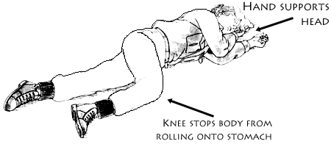
NALOXONE INTERVENTION
How to give nasal spray Narcan
Abstinence, or non-use, from opiate drug abuse is the most effective overdose prevention option
Recovery Position:
After Naloxone administration, place a recovering individual in the position shown here

Slide 16
NALOXONE INTERVENTION
Additional information
Abstinence, or non-use, from opiate drug abuse is the most effective overdose prevention option
Narcan should be stored between 36 to 77 degrees Fahrenheit
Narcan’s shelf life is about 2.5 to 3 years and the expiration date can be found on the bottom of the kit or back of the dose
Damaged or expired Narcan should be replaced ASAP
Narcan can be safely administered to anybody at any age

Slide 17
ADDITIONAL RESOURCES
HOPE DuPage: HOPEdupage.org
Recovery-Oriented System of Care (ROSC): DupageROSC.org
Live4Lali: Live4Lali.org
Illinois Helpline: HelplineIL.org or 1-833-2FINDHELP
Narcan Nasal Spray & Emergent BioSolutions: Narcan.com/en/
Abstinence, or non-use, from opiate drug abuse is the most effective overdose prevention option

Slide 18
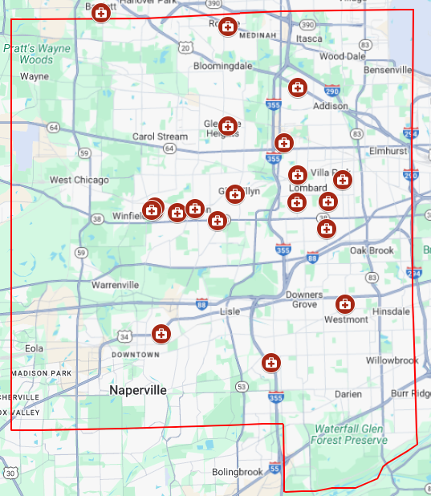
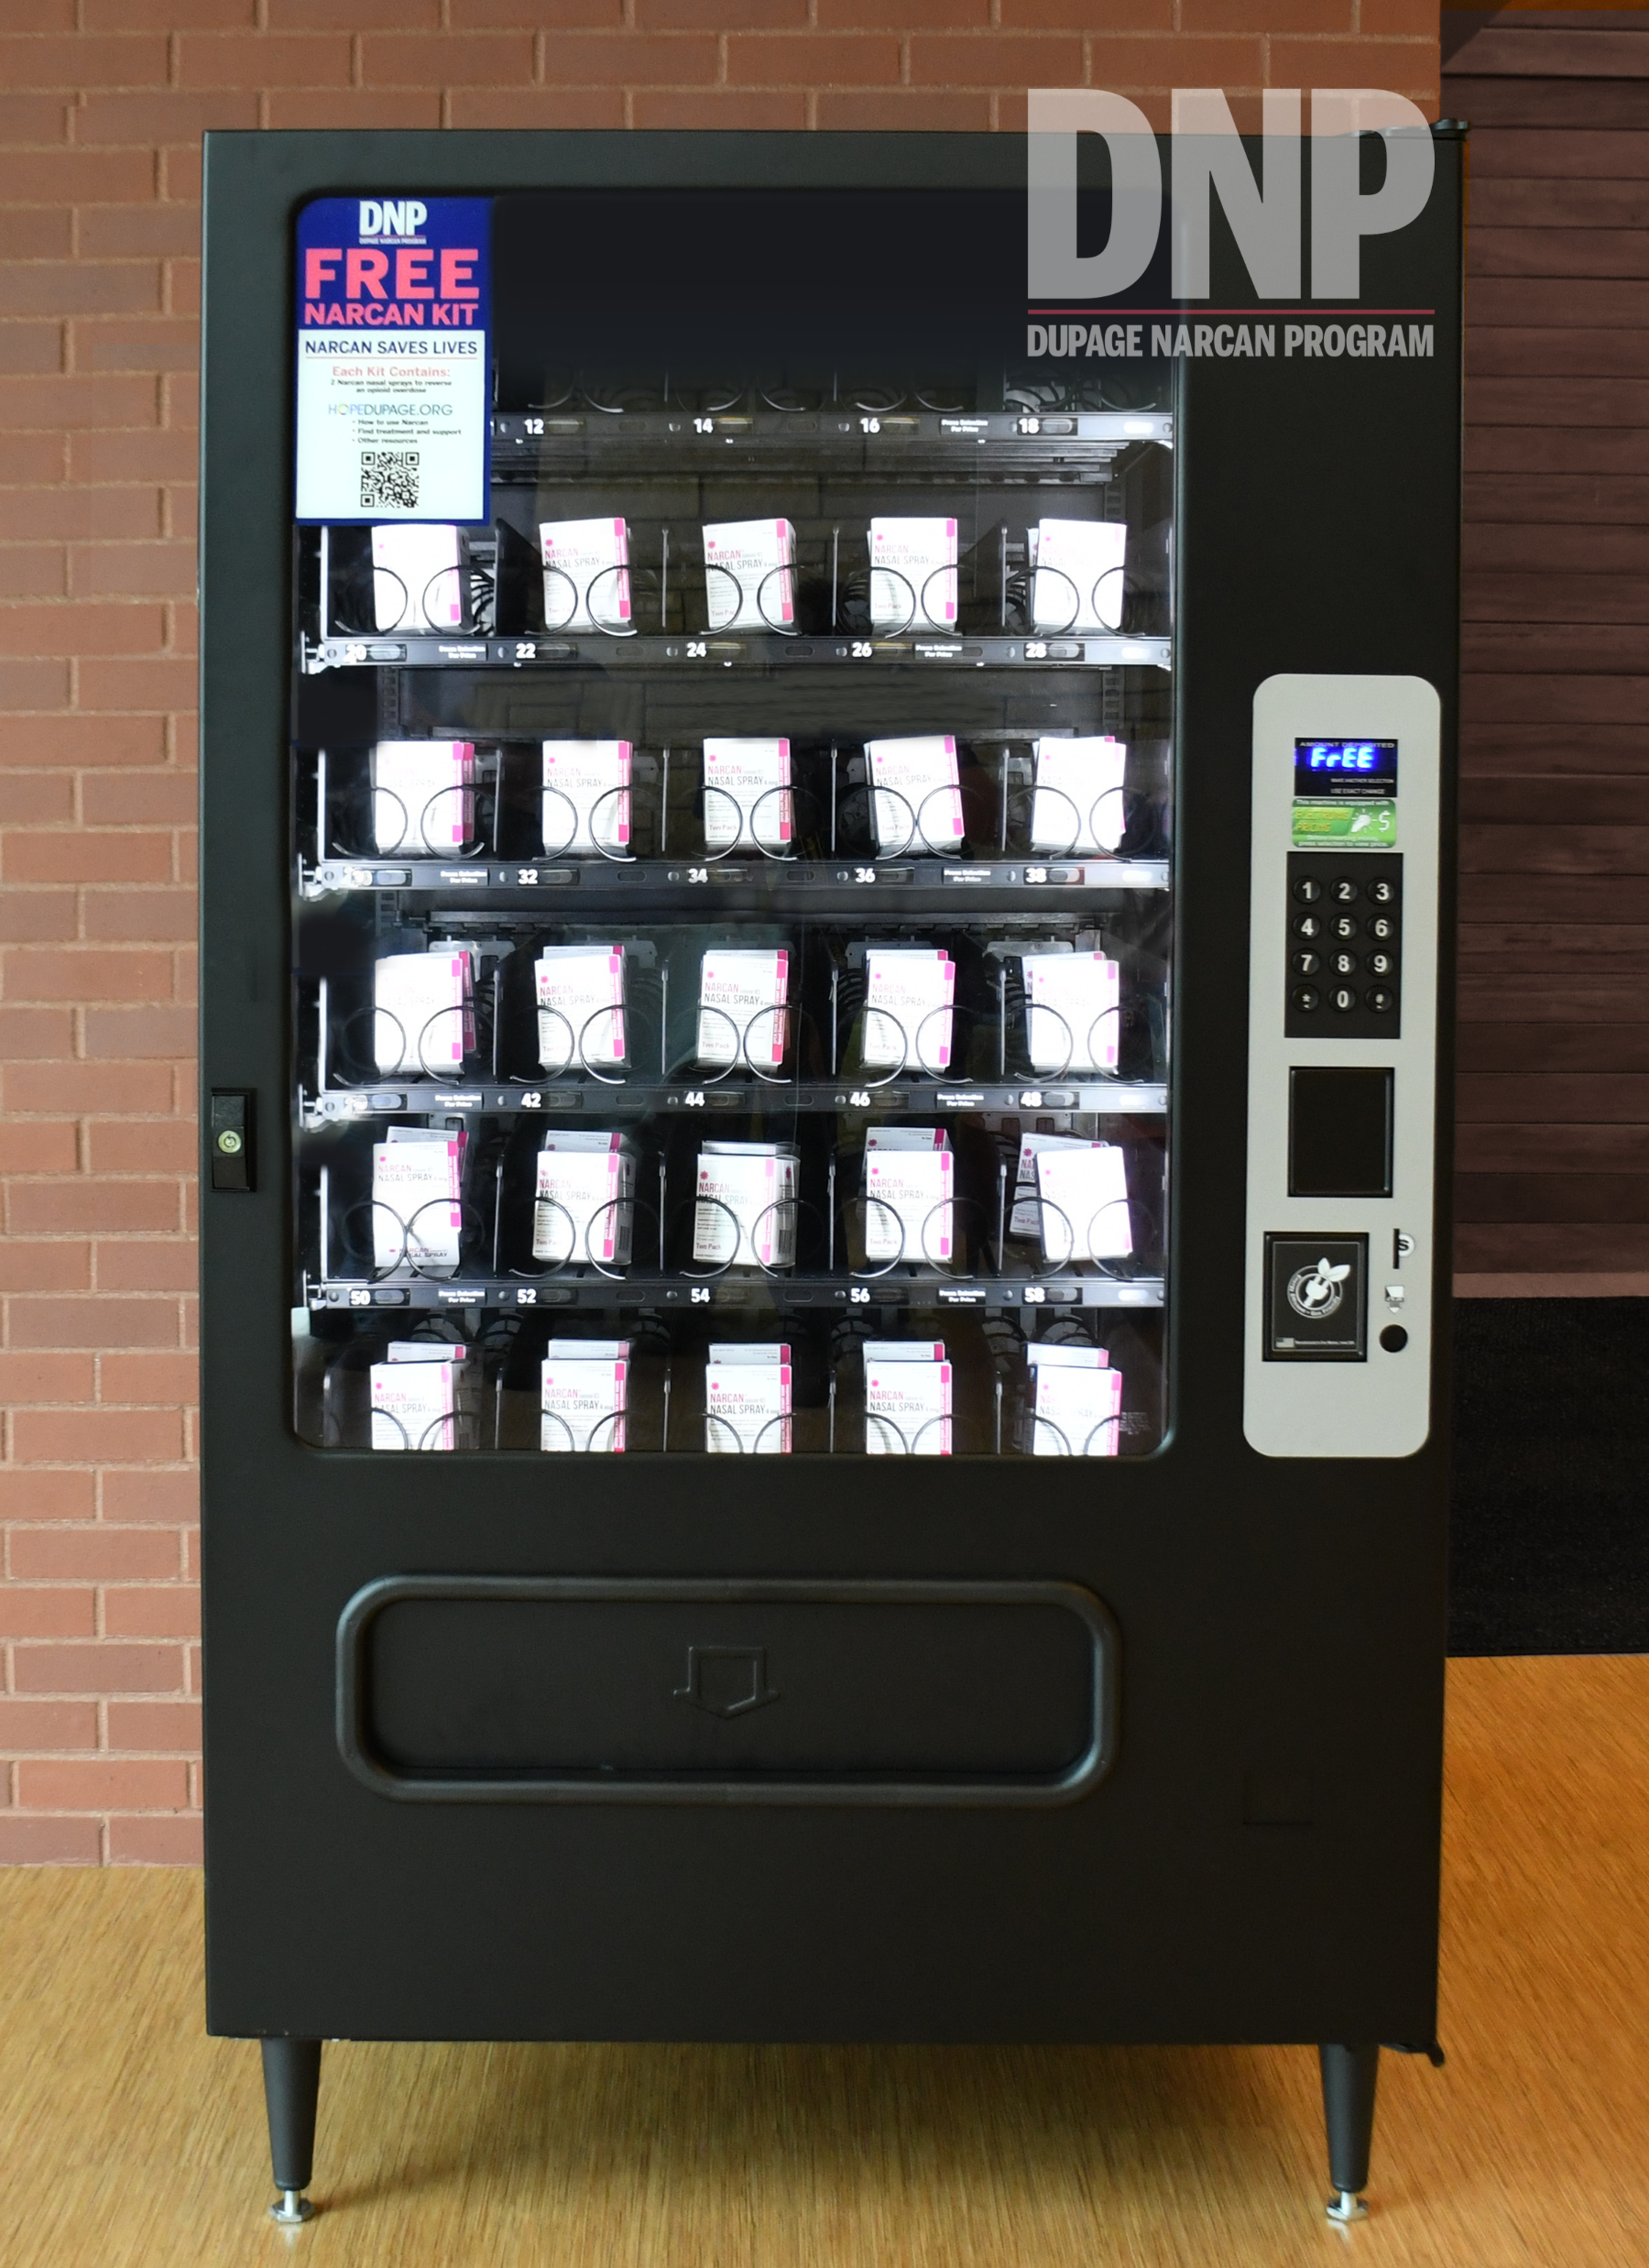
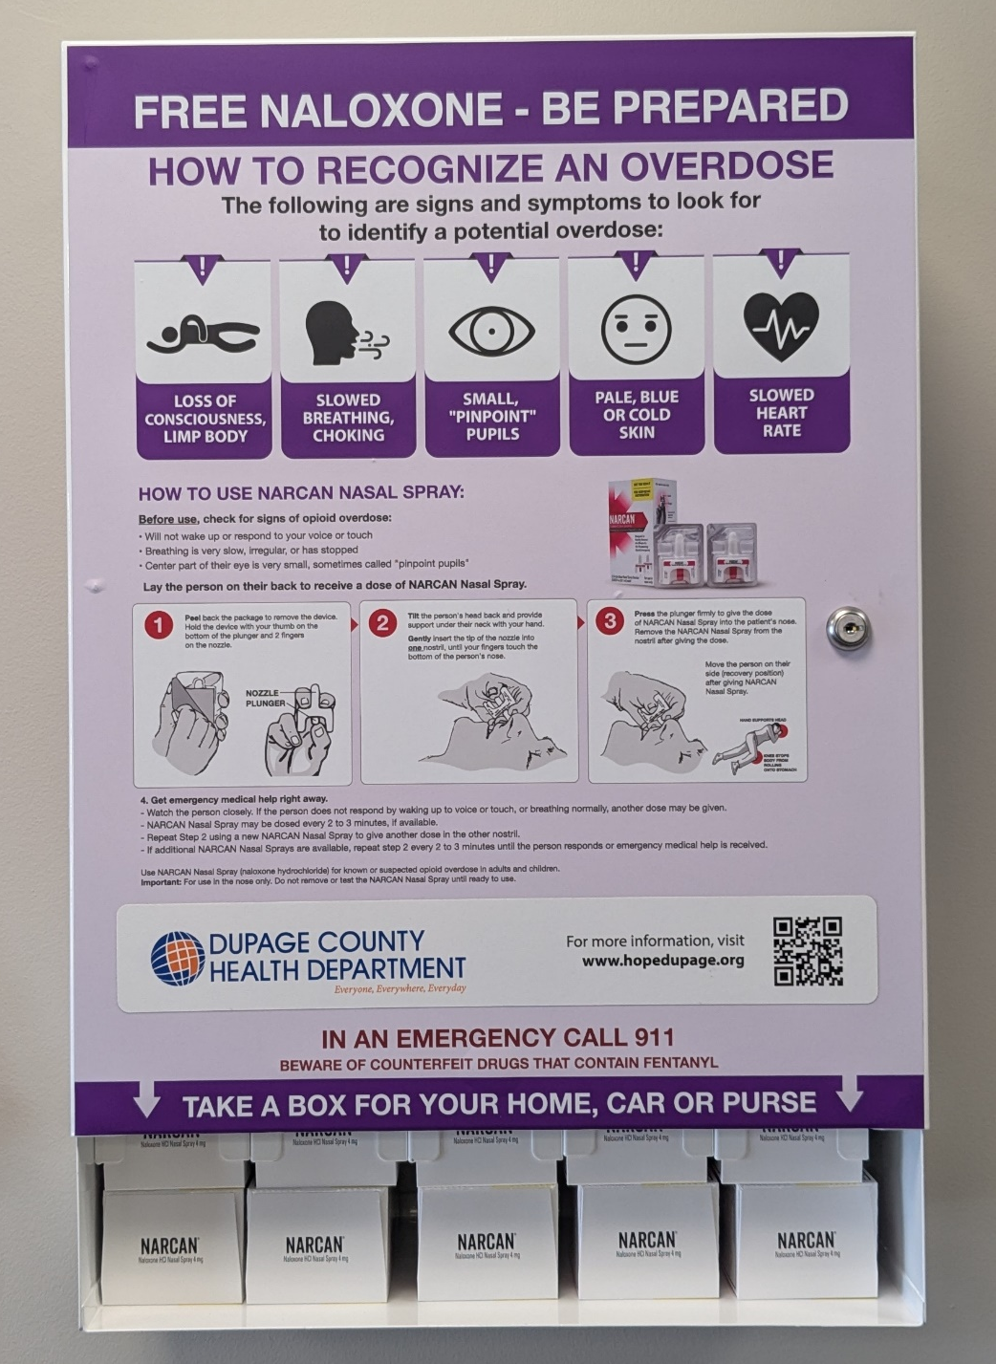
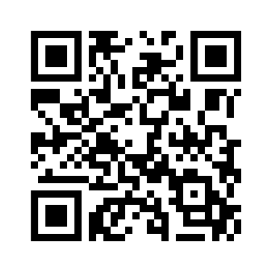
ADDITIONAL RESOURCES
Narcan available to the public via access sites and mailout program
Free of charge, no questions asked
Abstinence, or non-use, from opiate drug abuse is the most effective overdose prevention option
Map last updated July 2025

Slide 19
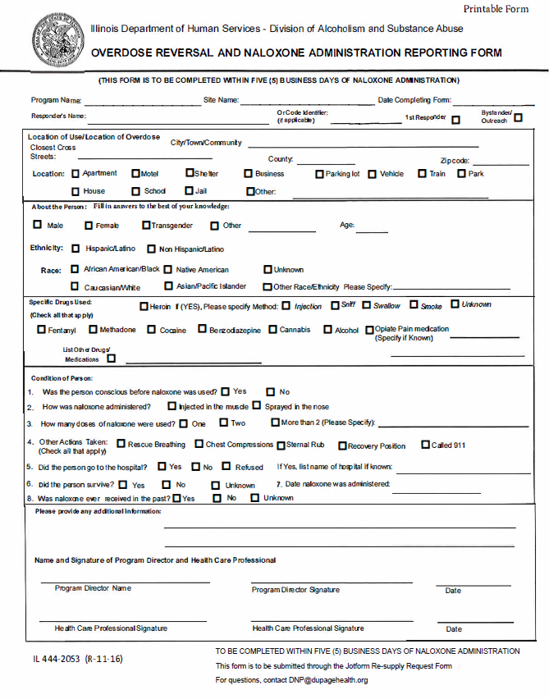
RELEVANT PROCEDURES
Documentation:
Naloxone Administration Reporting Form
This form is to be completed within FIVE business days of the naloxone administration
Questions?
Email DNP@DuPageHealth.org
Abstinence, or non-use, from opiate drug abuse is the most effective overdose prevention option

Slide 20
ANY QUESTIONS?
DNP@dupagehealth.org

