Slide 1
The role of opioids in chronic pain
William Campbell, D.O.
Board Certified in Family Medicine/Pain Medicine
October 9, 2019

Slide 2
Learning objectives
To become familiar with the most recent guidelines concerning safe opioid prescribing.
To develop comprehensive treatment plans, including the development of an algorithm that risk stratifies patients in the initiation and maintenance of controlled substances.
To address concerns about the multiple variables that may impact the level of comfort of physicians in prescribing opioids.

Slide 3
Patient Case #1
P.J. is a 46 yo construction worker complaining of worsening low back pain over the past 6 months.
He states that the pain has been present for over 10 years, is worse with activity, and does not radiate.
States that he also has trouble sleeping for the past few years.
Pain has resulted in him having difficulty going to work and completing tasks at his job.
Did physical therapy for 8 sessions last year, with ‘no improvement in pain.’

Slide 4
Patient Case #1
P.J. is a 46 yo construction worker complaining of low back pain for the past 6 months.
PMHx-DM2 (controlled), HTN, Lumbar DJD (confirmed by x-ray), Stage 2 CKD (GFR-72 at baseline)
PSHx- Tonsillectomy at age 6.
Social Hx- 1 ppd smoker, Negative x 2
Meds- Stagliptin 100mg QD, Atorvastatin 20mg QD, Lisinopril 5mg QD, Meloxicam 7.5mg QD
Physical Exam- Vitals WNL, Neuro exam negative, Kemp’s test positive b/l LS spine.

Slide 5
Patient Case #1
What is a reasonable next step in treatment?
Duloxetine 30mg daily
Hydrocodone/APAP 5/325mg 1-2 times per day PRN
Increase Meloxicam to 15mg daily
Tramadol 50mg PO 1-2 times per day PRN
Tylenol #3 PO 1-2 times per day PRN

Slide 6
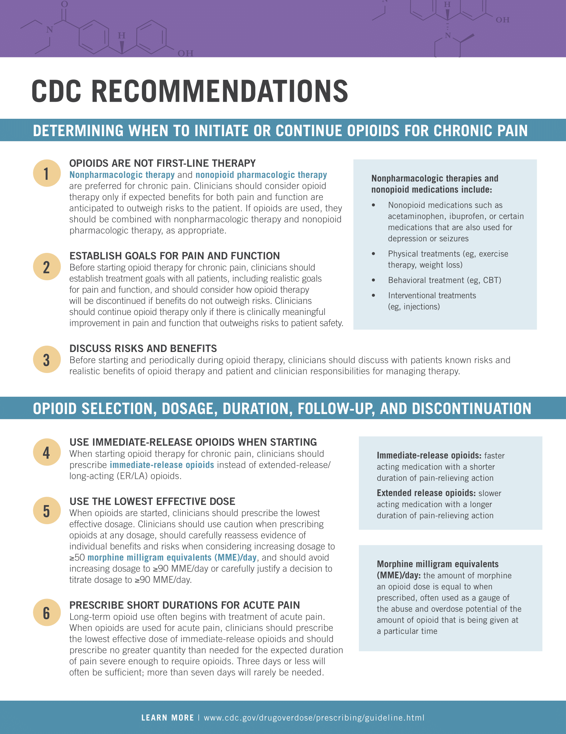
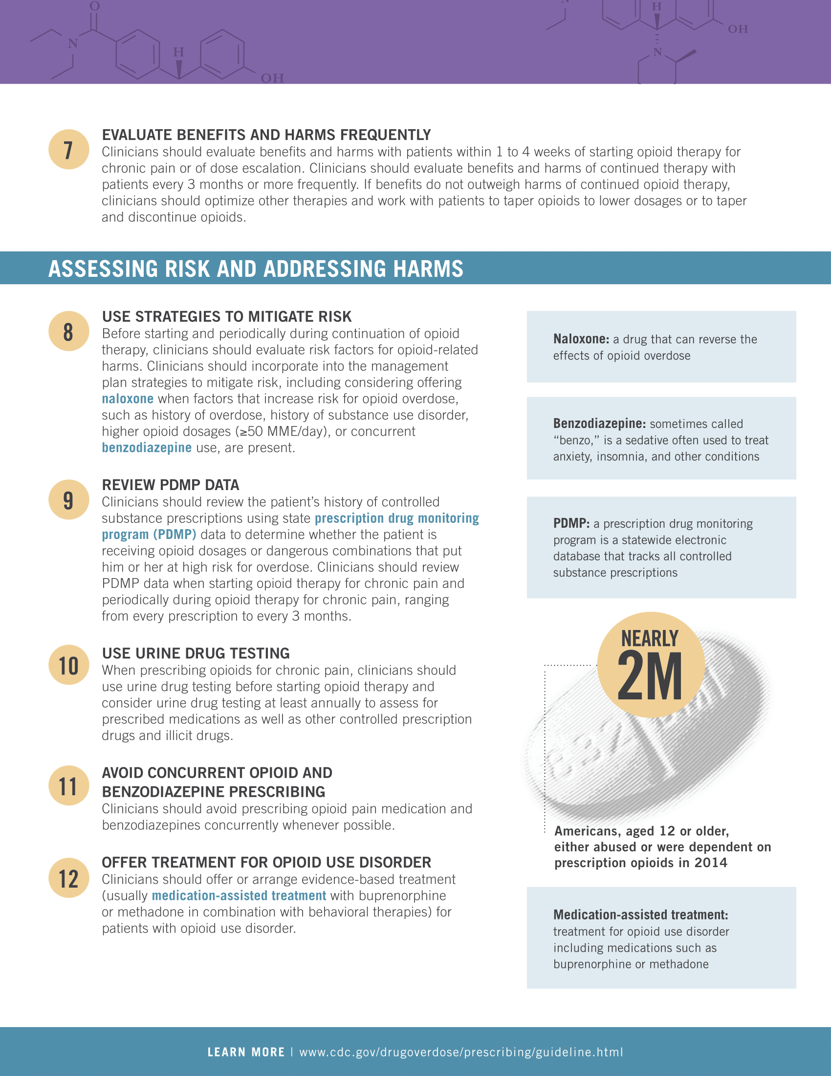

Slide 7
Treatment Algorithm
Risk Stratification
Comprehensive Treatment Plan
Opioid Monitoring

Slide 8
RIsk stratification
Opioid Risk Tool (ORT)
Screener and Opioid Assessment for Patients with Pain (SOAPP)
Prescription Monitoring Program
Medical Records
variable benefit

Slide 9
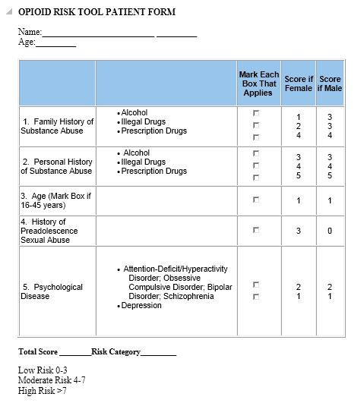

Slide 10
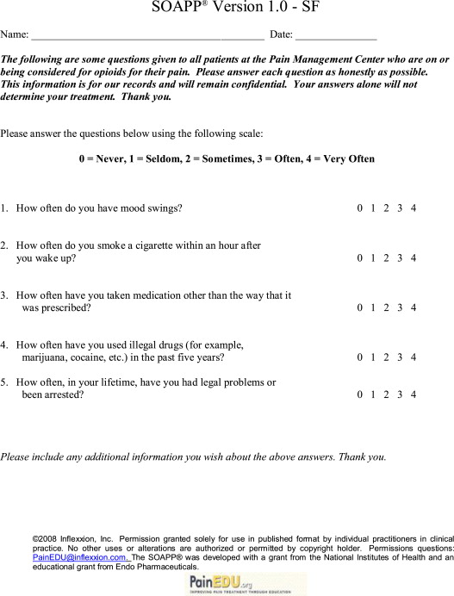

Slide 11
Comprehensive Treatment plan
Formulate and Confirm the chronic pain diagnosis!!!!
Misdiagnosis may lead to treatment regimens that are not effective.
Be sure to let the patient and their function be the primary guide, with imaging and labs confirming what the symptoms and exam say.
The prevalence of disk degeneration in asymptomatic individuals increased from 37% of 20-year-old individuals to 96% of 80-year-old individuals. Disk bulge prevalence increased from 30% of those 20 years of age to 84% of those 80 years of age. Disk protrusion prevalence increased from 29% of those 20 years of age to 43% of those 80 years of age. The prevalence of annular fissure increased from 19% of those 20 years of age to 29% of those 80 years of age.
AJNR Am J Neuroradiol. 2015 Apr; 36(4):811-816

Slide 12
Comprehensive Treatment Plan
Regardless of the cause of the chronic pain, patients can develop chronic pain syndrome. This involves the development of associated symptoms that are beyond pain alone. Symptoms include anxiety/depression, insomnia, irritability, drug or alcohol problems, job loss, suicidal thoughts, and marriage/family problems.
It is important to identify and address all of these symptoms, as patients frequently wrap all of their symptoms around their pain, and will make the false assumption that the relief of ther pain will solve the other problems.

Slide 13
Nociceptive Pain
A nociceptor is a nerve fiber preferentially sensitive to a noxious stimulus or to a stimulus that would become noxious if prolonged. Nociceptive pain is the perception of nociceptive input, usually due to tissue damage (eg, postoperative pain).
Types include: Osteoarthritis (most common), Rheumatoid Arthritis, Psoriatic Arthritis, Hemochromatosis.

Slide 14
Spondylosis (Spinal oa)
The primary symptoms of osteoarthritis (OA) are joint pain, stiffness, and locomotor restriction. Pain is worse with activity.
Clinical diagnosis — Peripheral joint OA may be diagnosed confidently on clinical grounds alone if the following are present:
Persistent usage-related joint pain
Age ≥45 years
Morning stiffness ≤30 minutes

Slide 15
Spondylosis (Spinal oa)
Appropriate imaging and laboratory investigations should be carried out in:
Younger individuals with joint symptoms/signs of OA
Presence of atypical symptoms and signs such as an unusual site of involvement, symptoms and signs of joint inflammation, marked rest and/or night pain, and rapidly progressive pain.

Slide 16
Spondylosis (Spinal oa)
Conventional radiography is the most widely used imaging modality in OA and allows for detection of characteristic features of OA including marginal osteophytes, joint space narrowing, subchondral sclerosis, and cysts
Physical exam tests to help diagnosis arthritis include SI compression test, Kemp’s Test, Patrick’s test (FABER), and Gaenslen’s test.

Slide 17
Neuropathic Pain
Neuropathic pain arises from abnormal neural activity secondary to disease, injury, or dysfunction of the nervous system.
Pain areas: in the back, face, foot, hands, or thigh
Pain types: can be burning and tingling or sharp
Pain circumstances: can occur at night
Sensory: pins and needles, uncomfortable tingling and burning, over sensitivity, reduced sensation of touch, or sensitivity to pain
Muscular: cramping, muscle weakness, problems with coordination, or loss of muscle
Also common: limping, slow reflexes, tingling feet, or tingling fingers

Slide 18
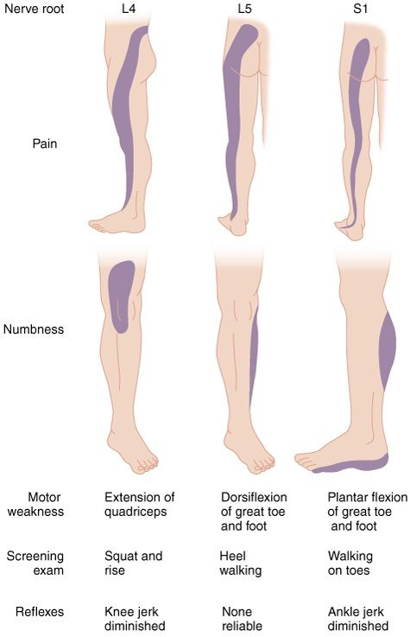

Slide 19
Lumbar Radiculopathy
L1- Uncommon, Inguinal pain possible.
L2, L3, L4- Radiating pain down anterior thigh, and interior lower leg. weakness of hip flexion, knee extension, and hip adduction. Sensation decreased down anterior thigh, medial lower leg. Reduced knee reflex.
L5- Most common. Pain down lateral lower leg, heel. Decreased strength in foot dorsiflexion, toe extension, foot inversion, and foot eversion. Weakness of leg abduction may also be present. Sensory loss at lateral aspect of the lower leg and dorsum of the foot. Reflexes are usually normal.
S1- Pain down the posterior aspect of the leg into the lateral foot. Weakness of plantar flexion is specific. Also weakness of leg extension and knee flexion. Sensation is generally reduced on the posterior leg and the lateral edge of the foot. Achilles reflex loss is typical.

Slide 20
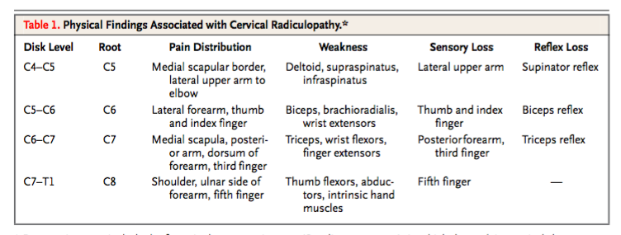
Cervical Radiculopathy

Slide 21
Neuropathic Pain
Post-Laminectomy Syndrome/Failed Back Syndrome
Persistent pain that occurs after a spinal surgery.
Occurs in 20% of patients who have surgery.
Can be the result of nerve scarring, post-op tissue scarring, spinal deconditioning.
Due to the irreversible nature of this pain, patients must be carefully selected before having surgery.

Slide 22
Neuropathic Pain
CRPS type 1- Chronic nerve disorder caused by tissue injury. (Surgery counts!)
90% of CRPS cases. Can be caused by surgeries, trauma. Symptoms may migrate from the site of injury.
CRPS type 2- Chronic nerve disorder caused by overt damage to nerve.
Symptoms mainly stay in the region where nerve injury occurred.
Phantom Limb Syndrome
Peripheral Neuropathy
Most likely cause is Diabetes Mellitus
Can also be autoimmune.

Slide 23
CNS Processing Pain
Fibromyalgia- a disorder characterized by widespread musculoskeletal pain accompanied by fatigue, sleep, memory and mood issues.
Researchers believe that fibromyalgia amplifies painful sensations by affecting the way your brain processes pain signals.
Diagnosis of exclusion.
Can be present WITH Nociceptive and Neuropathic pain disorders.
Before receiving a diagnosis of FM there was an average duration of 2.3 years and patients presenting to 3.7 different physicians.

Slide 24
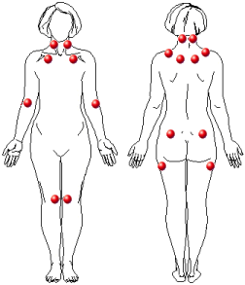
Fibromyalgia-1990 Criteria

Slide 25
Fibromyalgia-1990 Criteria
Symptoms of widespread pain, occurring both above and below the waist and affecting both the right and left sides of the body.
11 out of 18 tender points must be positive.
Difficult reproducibility based on variations in physician skill in administering the test.

Slide 26
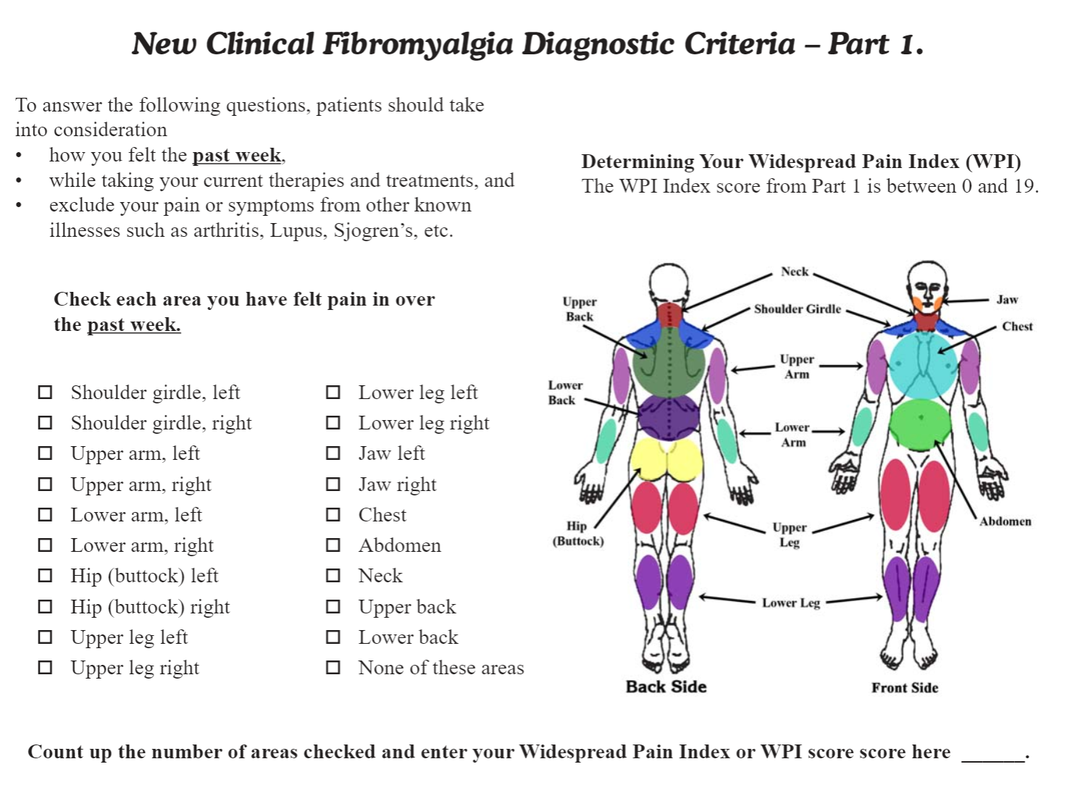

Slide 27
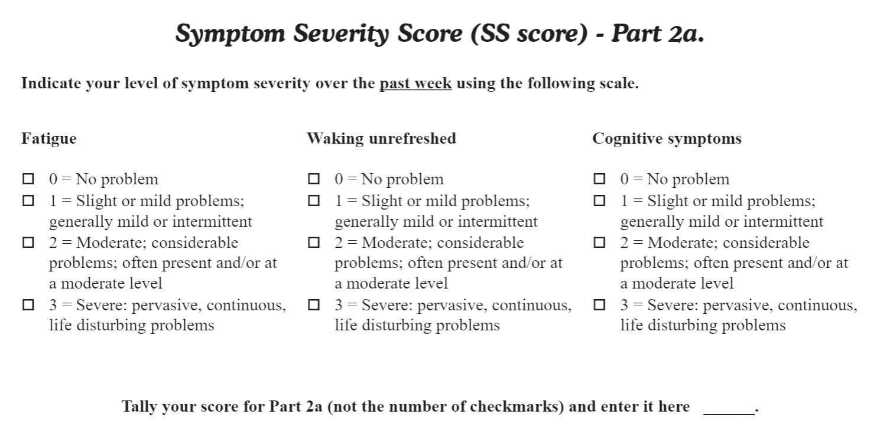

Slide 28
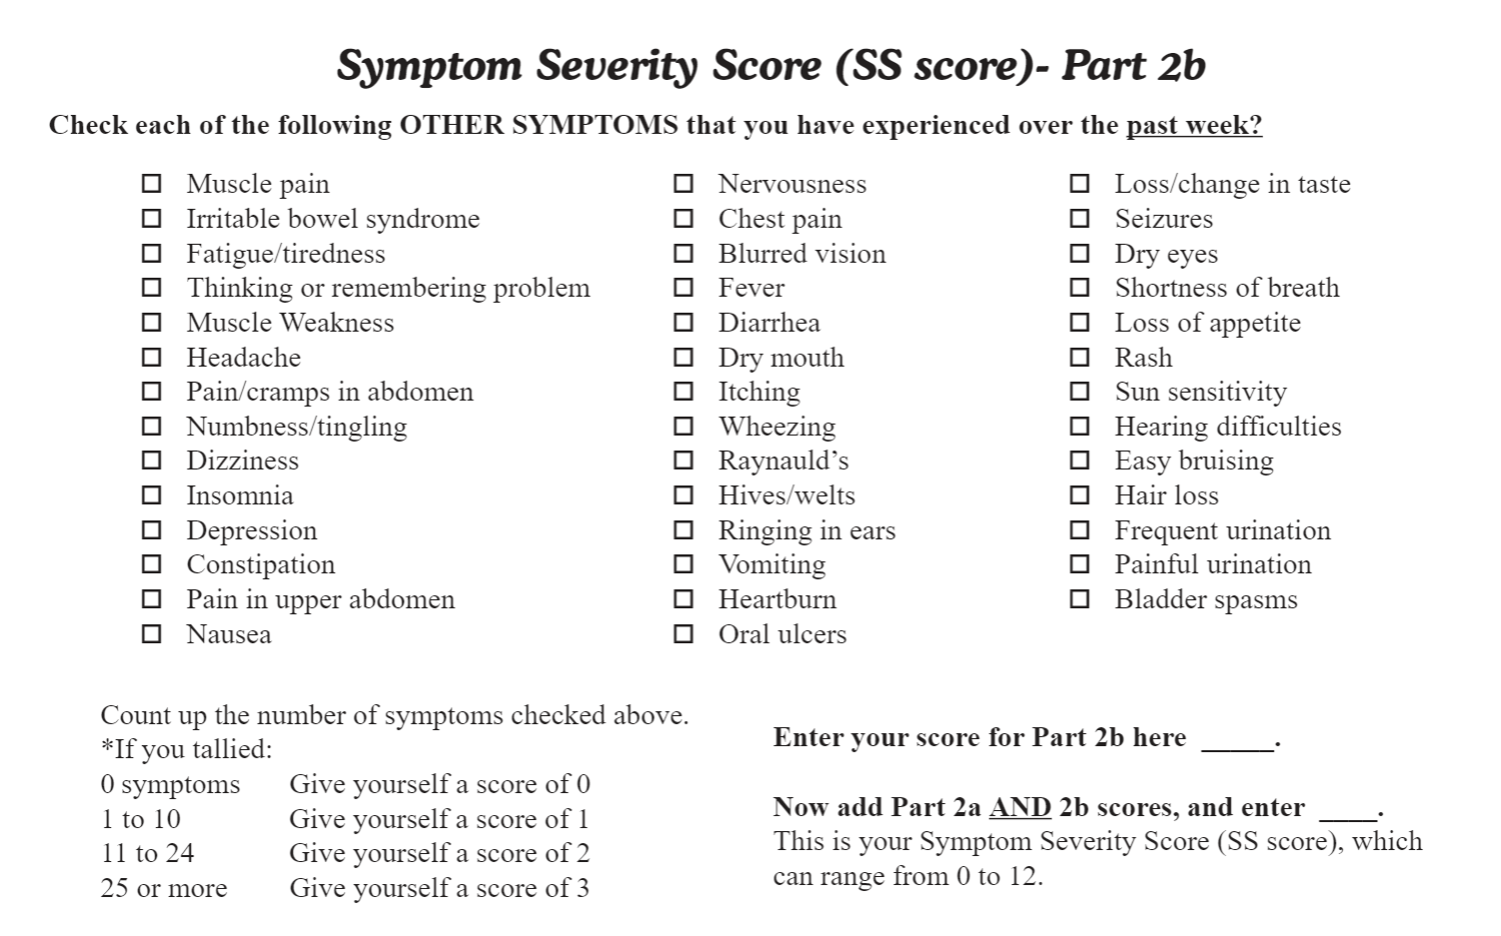

Slide 29
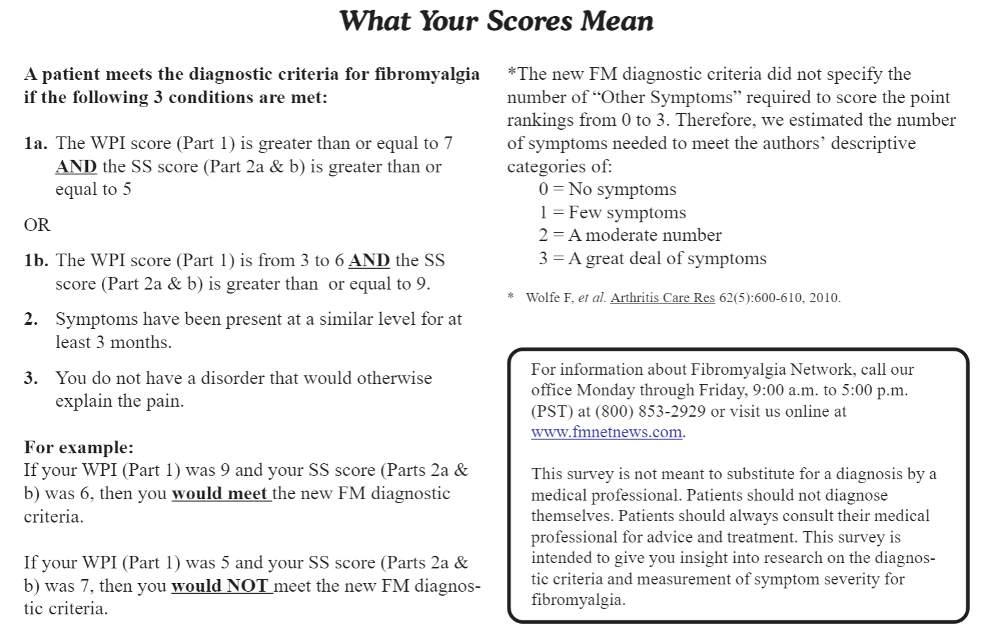

Slide 30
Fibromyalgia
It is acceptable to use 1990 criteria or 2010 criteria.
Once fibromyalgia has been diagnosed, treatment is focused on controlling ALL symptoms of the illness. They include the following:
Pain
Poor sleep hygiene
Depression/Anxiety
Fatigue

Slide 31
Goals of treatment
Goals of treatment are formulated around function. It is important to assess functional limitations, and determine together what are reasonable levels of improvement that can be attained with treatment.
In Chronic Pain patients, there will never be a pain level of ‘0’.
There is a big difference between a patient with 10/10 pain who is able to go to work everyday, and a patient with 10/10 pain who can’t get out of bed daily.
How patients ‘feel’ on a daily basis can greatly modulate a patient’s pain levels. It’s important to teach coping mechanisms when dealing with stressful situations. (“I overtook my norco because I’m going through a divorce…”)
Patients on disability may have an increased limitation on functional improvement. Increased emphasis must be placed on medication safety, while controlling pain and improving function when possible.

Slide 32
Opioid Monitoring
Prescription Monitoring Program
Patients are not to get controlled substances from other providers without notification and approval.
Patients are to notify provider within 48 hours after an ER visit.
Be aware of patients who are seeing psychiatrists and may be getting Benzodiazepines and/or stimulants from other providers.

Slide 33
Opioid Monitoring
Urine Drug Screening
Minimum for patients that are on opioids is annual.
May be as frequent as weekly, depending on the risk stratification, dosage, other co-prescribed controlled substances, and previously failed tests.
If patients are unable to urinate, there is a oral swab option (Quantitative)

Slide 34
Opioid Monitoring
Urine Drug Screening
Qualitative (screening) vs Quantative (confirmation)
Screening detects presence of a substance, while confirmation detects the concentration of a substance.
Screening can be done by Point of Care cups or strips (CLIA waived), or urine analyzer (Moderate CLIA lab certification required)

Slide 35
Opioid Monitoring
Urine Drug Screening
There are drug labs that will visit clinician offices to obtain the opportunity to run urine testing on patients.
Usually, these companies will run confirmatory tests on most, if not all tests that they receive. (Confirmatory tests were run to detect lower risk drugs, like Duloxetine and cyclobenzaprine)
Reimbursement for Urine Screening Test is $15-$60. Confirmation testing ranges from $250-$600.
Millennium Laboratories settled Medicare lawsuit for $256 million in 2015.

Slide 36
Opioid Monitoring
Urine Drug Screening (Health Solutions protocol)
Urine screening is done every 3 months for patients with a SOAPP score below 4, are on 40 MME or less, and are not simultaneously on other controlled substances.
Urine screens are done monthly when a patient has a SOAPP score at 4 or more, are on more than 40 MME, are on buprenorphine, or are also on other controlled substances. (benzodiazepines, stimulants, carisoprodol)
Testing frequency is increased or decreased as needed, depending on changes in status.

Slide 37
Opioid Monitoring
Pain Contract
Patient may not get controlled substances from other providers. If there is a situation where the ER gives the patient controlled substances, the patient MUST notify the office of the prescription.
Patient must agree to a COMPREHENSIVE treatment plan.
Patient must agree to Urine Drug Screening, at the discretion of the Physician.
Make patients aware of cost of screening and confirmation testing.
Reserve the right to dismiss a patient if they do not comply with the pain contract.

Slide 38
Patient Case #2
K.D. is a 42 yo salesman complaining of low back pain for the past 12 years. He is looking to establish care after moving here 1 month ago.
He states that the pain started when he had a MVA 12 years ago, while living in Ohio. He was sent to multiple specialists, without any resolution in his symptoms.
His pain is worse with activity, and does not radiate.
Pt sts that he was diagnosed with a herniated L5-S1 disk per MRI.
Did physical therapy, and Epidural injections, which ‘didn’t do anything.’

Slide 39
Patient Case #2
K.D. is a 42 yo salesman complaining of low back pain for the past 12 years. He is looking to establish care after moving here 1 month ago.
He has previously tried gabapentin and Flexeril, with no benefit.
He is currently being prescribed a fentanyl 100ug patch q 3 days, and Oxycodone 30mg 2 tablets 4 times per day.
Pt sts that he has been looking for another doctor to take over his care, but nobody would accept him.
Pt does have copies of his medical records, which state his medication dosages, and the MRI report does show a L5-S1 disc hernication with no neural foraminal narrowing or central canal stenosis. X-rays show mild-moderate lumbar facet arthritis.

Slide 40
Patient Case #2
K.D. is a 42 yo salesman complaining of low back pain for the past 12 years. He is looking to establish care after moving here 1 month ago.
PMHx-Lumbar Disc Herniation (??)
PSHx- Negative
Social Hx- Negative x 3
Meds- fentanyl 100ug patch q 3 days, and Oxycodone 30mg 2 tablets 4 times per day.
Physical Exam- Vitals WNL, Neuro exam negative, Positive FABER, Positive Kemp’s test b/l.

Slide 41
Patient Case #2
What reasonable conclusions can be drawn at this time?
This patient has a herniated disc, with associated neuropathy. Medications are appropriate for this condition.
This patient is clearly an addict, refer to addiction treatment
This patient has an arthritic picture. Medications are appropriate for this condition.
This patient’s previous doctor practiced based on outdated guidelines.
I don’t know what to think about this situation, but I don’t want anything to do with it. Refer this patient to anybody I can find.

Slide 42

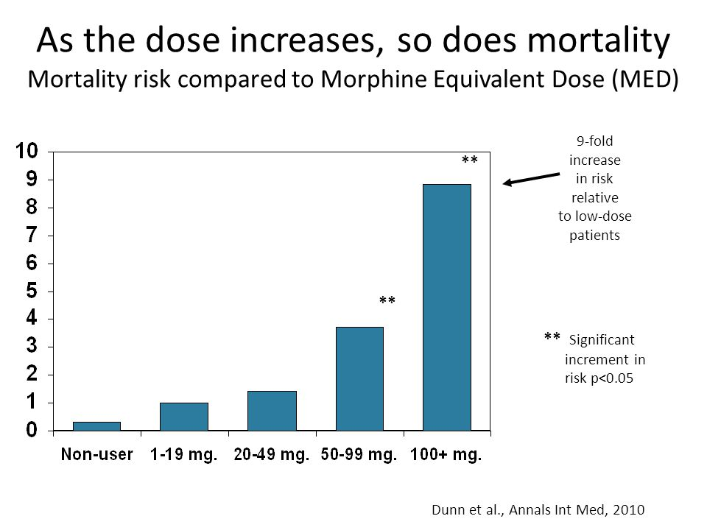
The numbers in the CDC guidelines are NOT arbitrary!!!

Slide 43
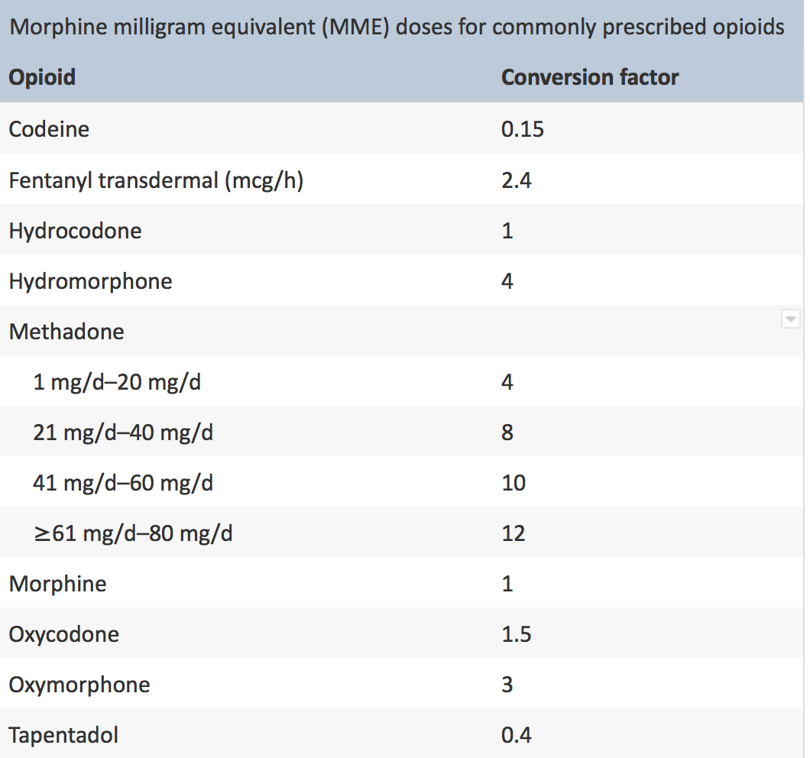
Morphine Equivalent calculation
Tramadol 50mg- 5 MME
Tylenol #3- 5 MME
Hydrocodone/APAP 5/325- 5 MME
Oxycodone/APAP 10/325- 15 MME
Fentanyl 12.5 uG- 30 MME

Slide 44
Patient Case #2
Calculated daily MME comes to 600.
This patient is on no other meds for his chronic condition.
If a clinician takes this patient’s case, how does one proceed?

Slide 45
Dependence
A physical dependence to opioids means that the body relies on a external source of opioids to prevent withdrawal.
Very predictable, results from chronic opioid usage.
Can be treated by tapering off opioids.
Clinicians must do patient risk/reward analysis to determine whether the benefits of increased function is worth the added symptoms of dependence.
Physical dependence does not indicate addiction!!!³
¹AAPM, APS, ASAM. 2001; http://www.ampainsoc.org/advocacy/opioids2.htm; ²Federation of State Medical Boards of the United States. http://www.fsmb.org/grpol_policydocs.html; 3McCarberg BH, Barkin RL. Am J Ther 2001;8(3):181-186.
Notes:
Dependence
Dependence is defined a natural state of adaptation characterized by a drug-class-specific withdrawal syndrome occurring upon cessation of drug intake, rapid dose reduction, decreasing blood level of a drug, or administration of an antagonist.^{1,2} Physical dependence alone does not mean that an individual is addicted to a substance.³
References: ¹The American Academy of Pain Medicine, the American Pain Society, and the American Society of Addiction Medicine. 2001; http://www.ampainsoc.org/advocacy/opioids2.htm. Accessed January 18, 2011; ²Federation of State Medical Boards of the United States. 2004; http://www.fsmb.org/grpol_policydocs.html; ³McCarberg BH, Barkin RL. Am J Ther 2001;8(3):181-186.

Slide 46
Addiction
A psychological ailment where functional impairment is present due to use continued use of the drug.
Characteristic behaviors include:
Impaired control over drug use
Compulsive use of drug, despite negative consequences of drug use.
Continued use even when it is physically hazardous.
Drug craving
Diagnosis of addiction should be based on a persistent, dysfunctional pattern of behavior.
AAPM, APS, ASAM. 2001; http://www.ampainsoc.org/advocacy/opioids2.htm;Federation of State Medical Boards of the United States. http://www.fsmb.org/grpol_policydocs.html.
Notes:
Addiction
Addiction is a primary, chronic, neurobiologic disease with hereditary, environmental and psychosocial influences on its development
Characteristic behaviors include:
Impaired control over drug use
Compulsive use of drug
Continued use despite harm
Drug craving
Diagnosis of addiction should be based on a pattern of behavior that is persistent and dysfunctional.
References:
Definitions related to the treatment of opioids for the treatment of pain: a consensus document from the American Academy of Pain Medicine, the American Pain Society, and the American Society of Addiction Medicine. 2001; http://www.ampainsoc.org/advocacy/opioids2.htm. Accessed January 18, 2011.
Federation of State Medical Boards of the United States. Model policy for the use of controlled substances for the treatment of pain. 2004; http://www.fsmb.org/grpol_policydocs.html.

Slide 47
Tolerance
Tolerance is also a state of adaptation
Drug exposure induces changes that reduce effect over time.
Increased dosage is required to produce a specific drug effect.
Tolerance is a normal physiologic response.
Opioid tolerance:
Can occur to both pain relief and side effects, at different rates
To pain relief, develops more slowly than to respiratory depression
To constipation may never occur
Tolerance does not indicate addiction.
AAPM, APS, ASAM. 2001; http://www.ampainsoc.org/advocacy/opioids2.htm;
Federation of State Medical Boards of the United States. http://www.fsmb.org/grpol_policydocs.html.
Notes:
Tolerance
Tolerance also represents a state of adaptation.
Drug exposure induces changes that result in reduced drug effect over time
Increased dosage is required to produce a specific drug effect
Tolerance is a normal physiologic response
Opioid tolerance:
Can occur to both pain relief and side effects, at different rates
To pain relief develops more slowly than to respiratory depression
To constipation may never occur
Tolerance of a substance does not indicate addiction.
References: The American Academy of Pain Medicine, the American Pain Society, and the American Society of Addiction Medicine. 2001; http://www.ampainsoc.org/advocacy/opioids2.htm. Accessed January 18, 2011; Federation of State Medical Boards of the United States. 2004. http://www.fsmb.org/grpol_policydocs.html.

Slide 48
Harm Prevention
Increased follow up frequency
Can schedule weekly or bi-weekly visits with prescriptions, until a level of clinician comfort is achieved.
Can also do serial Urine Drug Screens during those visits.
Naltrexone prescription
Intranasal administration.
Given when patients are on dosages above 50 MME, and/or if on concomitant benzodiazepines.

Slide 49
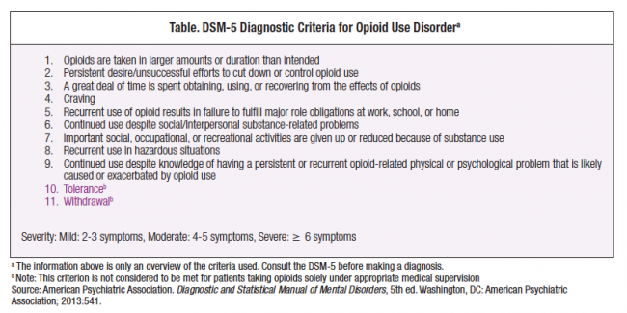

Slide 50
General Considerations
Benzodiazepine use with opioids
5 fold increase in overdose risk when given together during the first 90 days. Overdose risk steadily decreases after, likely due to tolerance.
Limited options for benzodiazepine dependence treatment. Limited evidence for pregabalin, flumazenil effectiveness.
There is no clear cut option for the safest benzodiazepine to use, but Alprazolam does appear to have the most abuse potential.

Slide 51
General considerations
Opioid tapering
Pre-2019, literature stated that one could safely taper opioids by 10% per week.
As of April 2019, FDA released a statement saying that rapid tapering may be harmful, and slower tapers should be initiated at a rate of 10-25% every 2-4 weeks. (??????)
If the decision to taper is made, clinicians must ask themselves if the tapering is for the patient’s comfort, or their own?

Slide 52
General Considerations
Obstacles to treatment
IDPR- Through prescription tracking, clinicians are being monitored for abnormal prescribing habits. Variables monitored include average daily MME per prescription, number of opioid prescribed, and number of patients with opioid and benzodiazepine prescriptions.
DEA- There is a database that monitors where every prescribed pain pill goes. There are anecdotal stories about DEA involvement in physician offices.

Slide 53
General Considerations
Obstacles to treatment
Health Systems- Due to the nebulous nature of the guidelines that we have, as well as the difficulty in streamlining any specific treatment algorhythm, health systems are refusing to allow the prescribing of opioids by their physicians. This has resulted in systemwide tapering efforts.
Patients- Physician perceptions that patients are taking advantage of them, lying to them about various issues.

Slide 54
When to Consider Opioids
Consider chronic opioid therapy (COT) once ALL of these conditions are met:
Failed analgesics
Pain-associated disability
Diagnosis is established
Patient complies with rehab therapy
Side effects
Excessive doses needed for response
Inadequate reduction of pain
Contraindication to NSAIDs
ADL
Social/family role
Work
Documented patients
Full evaluation completed
Clear pain diagnosis
Non-opioid medication trials
Psychological treatment
PT/OT
Marcus DA. Chronic pain: a primary care guide to practical management. Second ed. New York, NY: Humana Press; 2009.
Notes:
When to Consider Opioids
Consider chronic opioid therapy (COT) when all of these conditions are met:
Failed analgesics
Pain-associated disability
Diagnosis is established
Prescribe only for documented patients, never for non-patients (yourself, relatives, employees, friends)
Prescribe only once the full evaluation is completed
Prescribe opioids only for patients whose diagnosis of chronic pain is clear
Patient complies with rehabilitation therapy
Source: Marcus DA. Chronic pain: a primary care guide to practical management. Second ed. New York, NY: Humana Press; 2009.

Slide 55
Summary
Know your comfort level.
You can’t treat an asymptomatic patient.
Consistency is Key
Patients want validation, Doctors want solutions.
“Test questions are easier than people.”

