Slide 1
Solutions to Our Nation’s Opioid Crisis The Naloxone Plus Pre-Arrest Diversion Framework
Jac Charlier National Director for Justice Initiatives jcharlier@tasc.org 312-573-8302
© 26 February 2018

Slide 2
The Naloxone Plus Framework: Designed for Saving Lives – Twice

Slide 3
Variety of Terms for Pre-Arrest Diversion
Deflection
Pre-arrest diversion (PAD)
Pre-booking
Co-responder
Pre-booking
Crisis Intervention Teams
Police diversion
Crisis/Triage centers
Police assisted diversion
Law enforcement encounter
Law enforcement assisted diversion (LEAD)
No arrest diversion
A Third Way for Law Enforcement 1) Arrest or 2) Release 3) Divert (New!)

Slide 4

Pre-Arrest Diversion Is the “Handle” on the Front Door of the US Justice System People who are nonviolent can be diverted to treatment and services in the community instead of entering the justice system.
Community-based services, housing, and recovery support
Pre-Adjudication Diversion
Post-Adjudication
Police
First responders
Initial detention
Initial court hearings
Prosecutors
Jail
Court
Jail Reentry
Prison reentry
Probation
Parole
Notes:
Over the years we have learned that the justice system has iatrogenic effects—a term borrowed from medicine that means the cure is worse than the disease. In criminal justice, we call it “collateral consequences.”
Years of success in problem solving courts and reentry has enabled us to learn this and look “upstream” for earlier points of interventions, to diversion or deflection, to achieve our goals of increasing public safety and improving public health.
Intervening earlier, before the extreme collateral consequences have stacked up, is often also less costly than waiting to serve people until they have moved deeper into the system.

Slide 5
How Pre-Arrest Diversion (PAD) Differs from Other Types of US Justice Diversion
Pre-Arrest Diversion (PAD)
Moving away from justice system without having entered it
Behavioral health guided with criminal justice partnerships
Public health solution to better public safety – crime reduction!
Other Criminal Justice Diversion
Moving out of justice system after having entered it
Criminal justice guided with behavioral health partnerships
A wide variety of approaches for a variety of reasons

Slide 6
Two Types of Pre-Arrest Diversion: Done Together for Biggest Impact
Prevention PAD
No charges / Not relevant to criminal activity during this encounter
Identified behavioral health issue (well-being) that places the person in a health risk or exposure risk to the justice system
Divert to treatment for clinical assessment to address needs and/or to social services
Intervention PAD
Charges exist but are held in abeyance or issuance of non-criminal citation
Identified behavioral health issue (well-being) that places the person in a health risk or exposure risk to the justice system AND
Identified low-moderate risk (to re-offend)
Divert to treatment for clinical assessment to address needs and/or to social services with justice follow-up and possible action

Slide 7
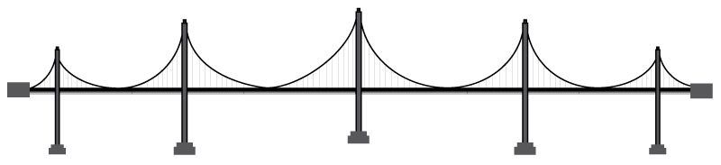
The Pathways to Treatment Connecting Two Systems (The TASC Model)
100% Identification & Screening
Referral/Placement
into Treatment
Monitoring & Reporting
Assessment
Recovery Support
Justice System
Treatment System
Case Management, Collaboration, Systems Communication
Community
800,000 Police Referring to Treatment (New!)
Notes:
We help criminal justice systems address the underlying needs of people who end up in them so they don’t keep cycling through.
Benefits to the system:
Standardized means of accessing treatment and other services for clients
Clearly defined client eligibility criteria
Screening procedures for client identification
Documented procedures for assessment and referral
Monitoring and reporting of client progress
We help individuals get access to services and stay in the services they need.
Benefits to the individual, family, and community:
Client strengthens personal capacity & community supports to help maintain recovery beyond supervision

Slide 8
The Five PAD Pathways to Treatment
Self-Referral: Individual initiates contact with law enforcement for a treatment referral (without fear of arrest); preferably a warm handoff to treatment
Active Outreach: Law enforcement intentionally IDs or seeks individuals; a warm handoff is made to treatment, which engages individuals in treatment
Naloxone Plus: Engagement with treatment as part of an overdose response or DSM-V severe for opiates; tight integration with treatment, naloxone (individual too)
Officer Prevention Referral: Law enforcement initiates treatment engagement from a call for service or “on view”; no charges are filed
Officer Intervention Referral: Law enforcement initiates treatment engagement from a call for service or “on view”; charges are held in abeyance or citations issued, with requirement for completion of treatment

Slide 10
Pre-Arrest Diversion Examples (Brands) with Related Pathways
Angel (MA) / Arlington (MA) – paariusa.org; Fire = Safe Stations
(435 sites for Angel and Arlington programs – PD, Sheriff, Fire/EMS)
Self-referral, Active Outreach
QRT, DART (OH) – (many and varied sites with QRT 50+ sites)
Naloxone Plus
LEAD (WA) – leadkingcounty.org (20 sites)
Officer Prevention Referral, Officer Intervention Referral
Civil Citation (FL) – civilcitationnetwork.com (62 sites: 60 juvenile, 2 adult)
Officer Intervention Referral
STEER (MD) – CenterforHealthandJustice.org (1 site)
Naloxone Plus, Officer Prevention/Intervention Referral

Slide 11
Why Pre-Arrest Diversion Growth Now?
Law enforcement encounters with the mentally ill
CIT – 1988 – “Memphis Model”
Police and community relations
Brown - Ferguson, MO; McDonald – Chicago, IL
President's 21st Century Task Force – 2015
Opioid epidemic
“Angel” program - 2015
Ever increasing “social burden” on police and the justice system
War on Crime – Johnson – 1965
War on Drugs – Nixon – 1971
Violent Crime Control Act – Clinton – 1994
Rapid growth in incarceration (2x growth/10 years) 1980 +/-

Slide 12
Pre-Arrest Diversion: Part of the Solution
Reduced crime
Improved public safety (real and perceived)
Reduced drug use
Better outcomes during crisis encounters
Lives saved, lives restored
Building police-community relations
Reduced burden on criminal justice to solve public health and social challenges – reduction in the “social burden”
Building (more) police-public health/behavioral health relations
Correct movement of citizens into/away from the justice system
Cost savings
“Net-narrowing”
Keeping families intact
Addressing racial disparity

Slide 13
Pre-Arrest Diversion: Observations
Newly emerging field and profession
Formalized: Policy, Practice and Training
Systems approach: Police + Treatment + Community + Research
Research is promising
First steps underway to establish a policy framework
Mental health is not illegal
Drugs are (mostly) illegal
Mental health tends to think of crisis situations
SUD does not rely on a crisis situation
Social services, housing, recovery
Family, children, veterans

Slide 14
The Naloxone Plus Framework: The National Standard for Opioid Response

Slide 15
Elements of the Naloxone Plus Framework
Naloxone Plus: Engagement with treatment as part of an overdose response with naloxone, then following up rapidly with tight integration with treatment. Site examples: QRT, DART, STEER
Naloxone – Law enforcement, fire, emergency medical services, community, businesses, individuals, etc.
Rapid ID – e.g., 9-1-1
Immediate contact with individual – as close as possible to point of OD
Rapid engagement – in person and daily follow-up until engaged in treatment
Rapid access to treatment – measured in minutes and hours
Screening and clinical assessment – to have the correct individual approach
Continued tight integration – police and behavioral health and community
Medication-Assisted Treatment (MAT) – all appropriate medications made available
Recovery support services – treatment ends, recovery continues
Naloxone – for the individual and his/her household

Slide 16
The Pathways to Treatment Connecting Two Systems (The TASC Model)
100% Identification & Screening
Referral/Placement
into Treatment
Monitoring & Reporting
Assessment
Recovery Support
Justice System
Treatment System
Case Management, Collaboration, Systems Communication
Community
800,000 Police Referring to Treatment (New!)
Notes:
We help criminal justice systems address the underlying needs of people who end up in them so they don’t keep cycling through.
Benefits to the system:
Standardized means of accessing treatment and other services for clients
Clearly defined client eligibility criteria
Screening procedures for client identification
Documented procedures for assessment and referral
Monitoring and reporting of client progress
We help individuals get access to services and stay in the services they need.
Benefits to the individual, family, and community:
Client strengthens personal capacity & community supports to help maintain recovery beyond supervision

Slide 17
Why Case Management: Most individuals entering the justice system have multiple & complex service needs
Source: Community Catalyst, 2016
Notes:
People come into the system with a complexity of needs
Where do we start? The role of case management is to identify client needs and assets, to educate and empower clients, to address social determinants of health, and to coordinate care.
Additionally, case managers are advocates for clients: advocates for access, advocates for reasonable expectations and timelines, advocates for services promised by community providers.
And case managers ensure communication between all partners in the care of this client—service providers, court, probation, client and family.

Slide 18

Signs of Recovery Over Time
Duration of Abstinence
1-3 Years
1-12 Months
4-7 Years
More abstinent friends
Less illegal activity and incarceration
Less homelessness, violence, and victimization
Less use by others at home, work, and by social peers
Virtual elimination of illegal activity and illegal income
Better housing and living situations
Increasing employment and income
More social and spiritual support
Better mental health
Housing and living situations continue to improve
Dramatic rise in employment and income
Dramatic drop in people living below the poverty line
© 2014
Source: Dennis, Foos & Scott, 2007

Slide 19
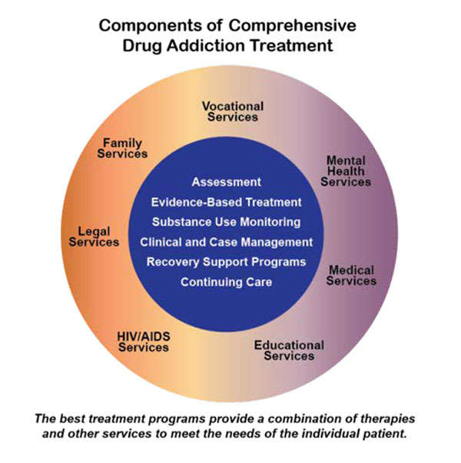
National Institute of Drug Abuse
Notes:
If you had to draw a picture of what treatment should look like, this would be it!

Slide 20
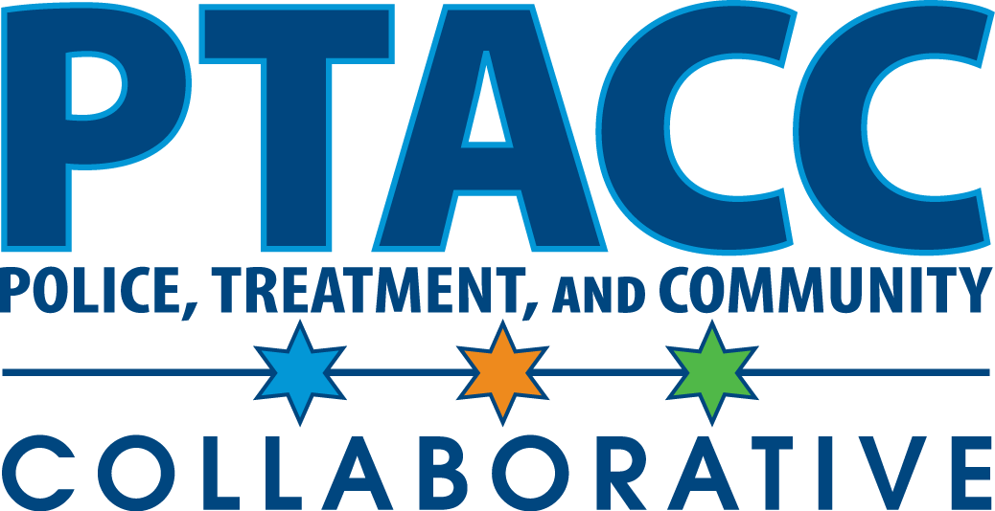
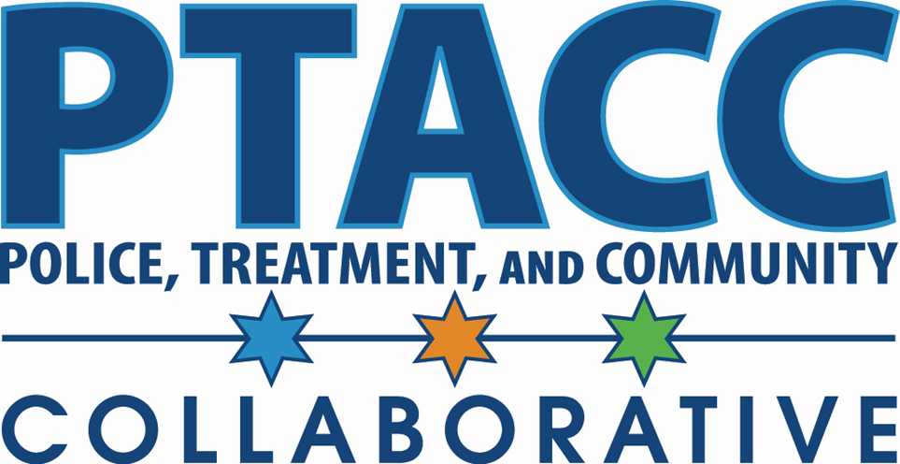
The NATIONAL Voice of the
Pre-Arrest Diversion Field

Slide 21
PTACC Collaborative: Our Mission, Purpose, and Cornerstone
Mission – To strategically enhance the quantity and quality of community behavioral health and social service options through engagement in pre-arrest diversion
Purpose – To provide NATIONAL vision, leadership, advocacy, and education to facilitate the practice of pre-arrest diversion across the US
Cornerstone – PTACC is opensource, open to any and all. PTACC is “non-denominational” as to which model/brand of pre-arrest diversion is appropriate for a jurisdiction; each community must determine which approach(es) solves its problem, fits the local situation, and can be addressed through current behavioral health capacity.

Slide 22
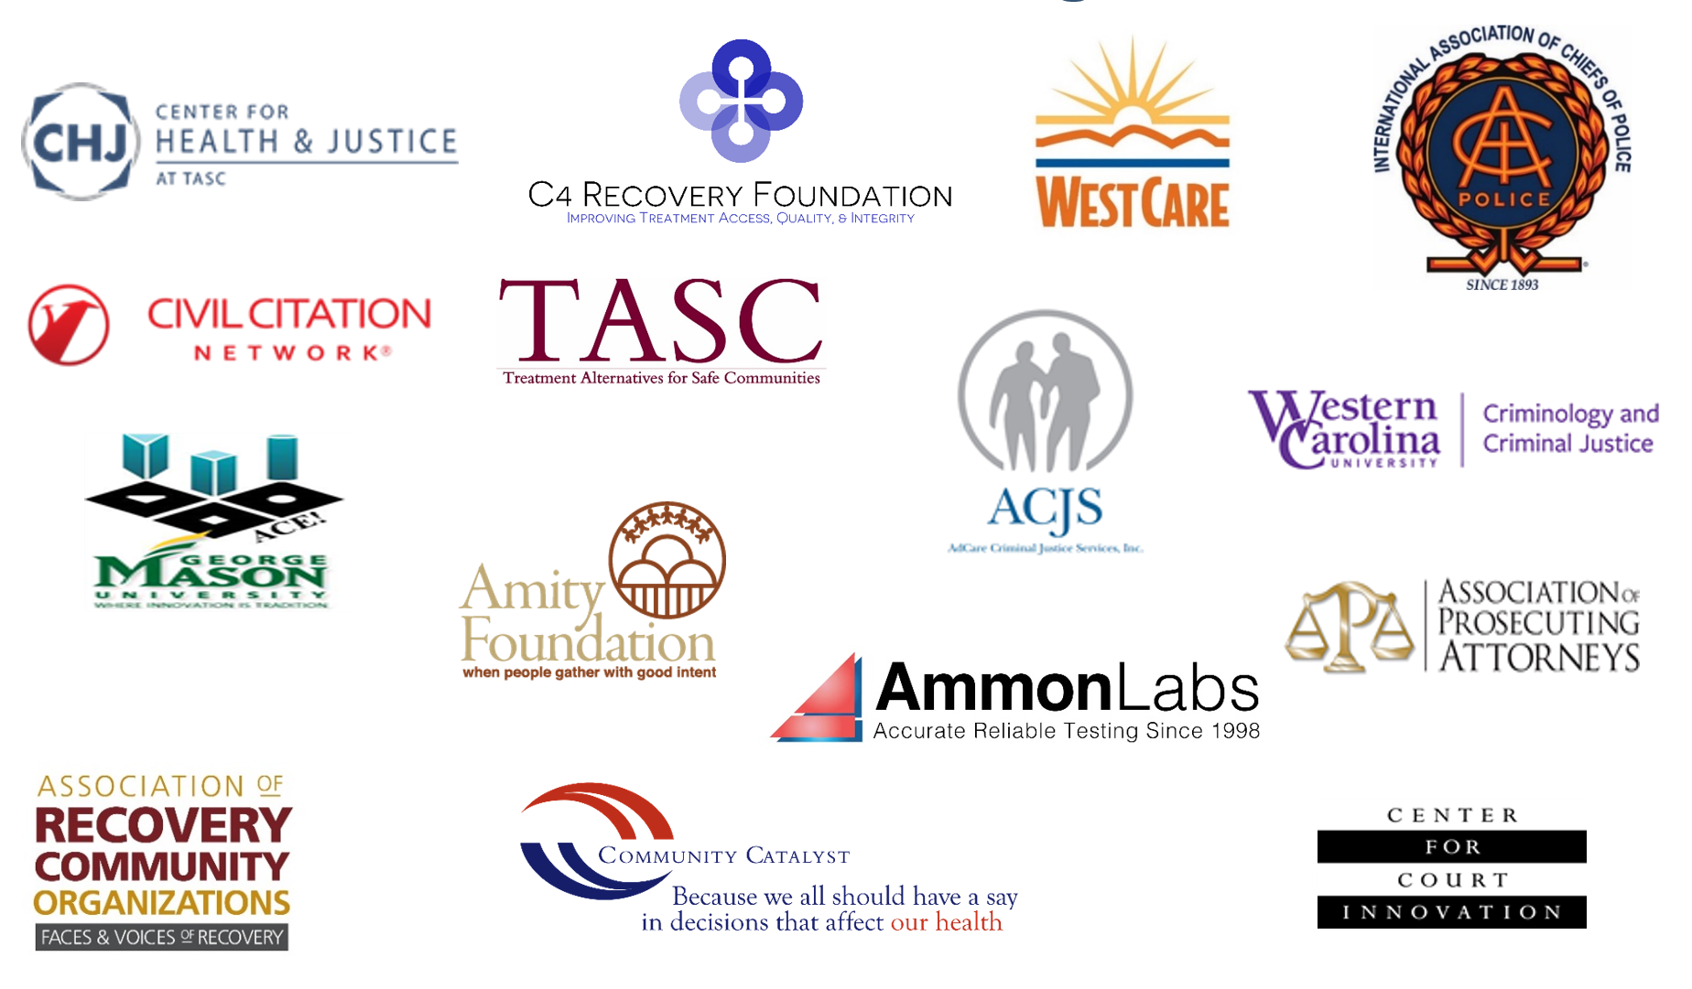
PTACC Collaborative: Our 27 National Founding Partners

Slide 23
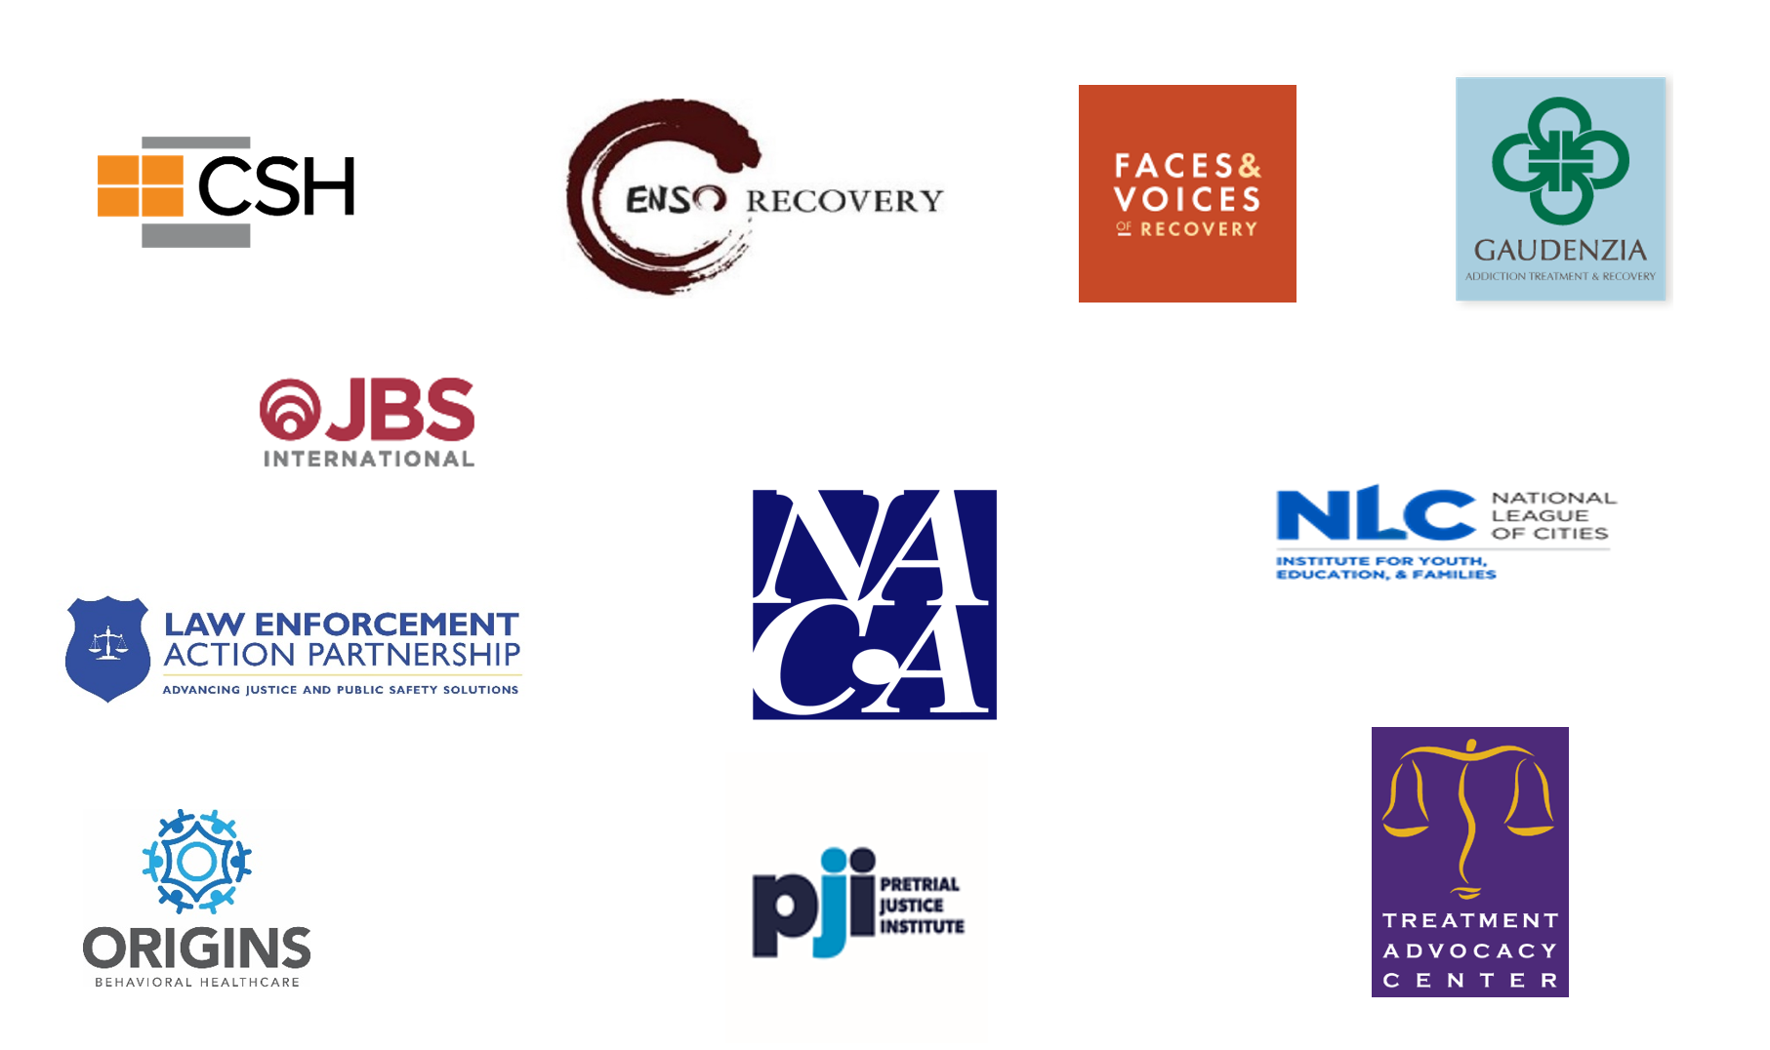

PTACC Collaborative: Our 27 National Founding Partners

Slide 24
PTAC “Opensource” Resources:
PTACC Visual 5 Pathways to Treatment – The first visual depiction of all known deflection and pre-arrest diversion pathways
PTACC Core Measures of Pre-Arrest Diversion – Recommended metrics for sites to use covering police, treatment, community, and race.
PTACC 11 Guiding Principles for Behavioral Health Pre-Arrest Diversion – Currently being aligned with CARF accreditation standards.
PTACC Pre-Arrest Diversion Presentations – PAD Basics, PAD Policy, Naloxone Plus
PTACC National Policy and Legislation – In development
PTACC Housing & Pre-Arrest Diversion – In development

Slide 25
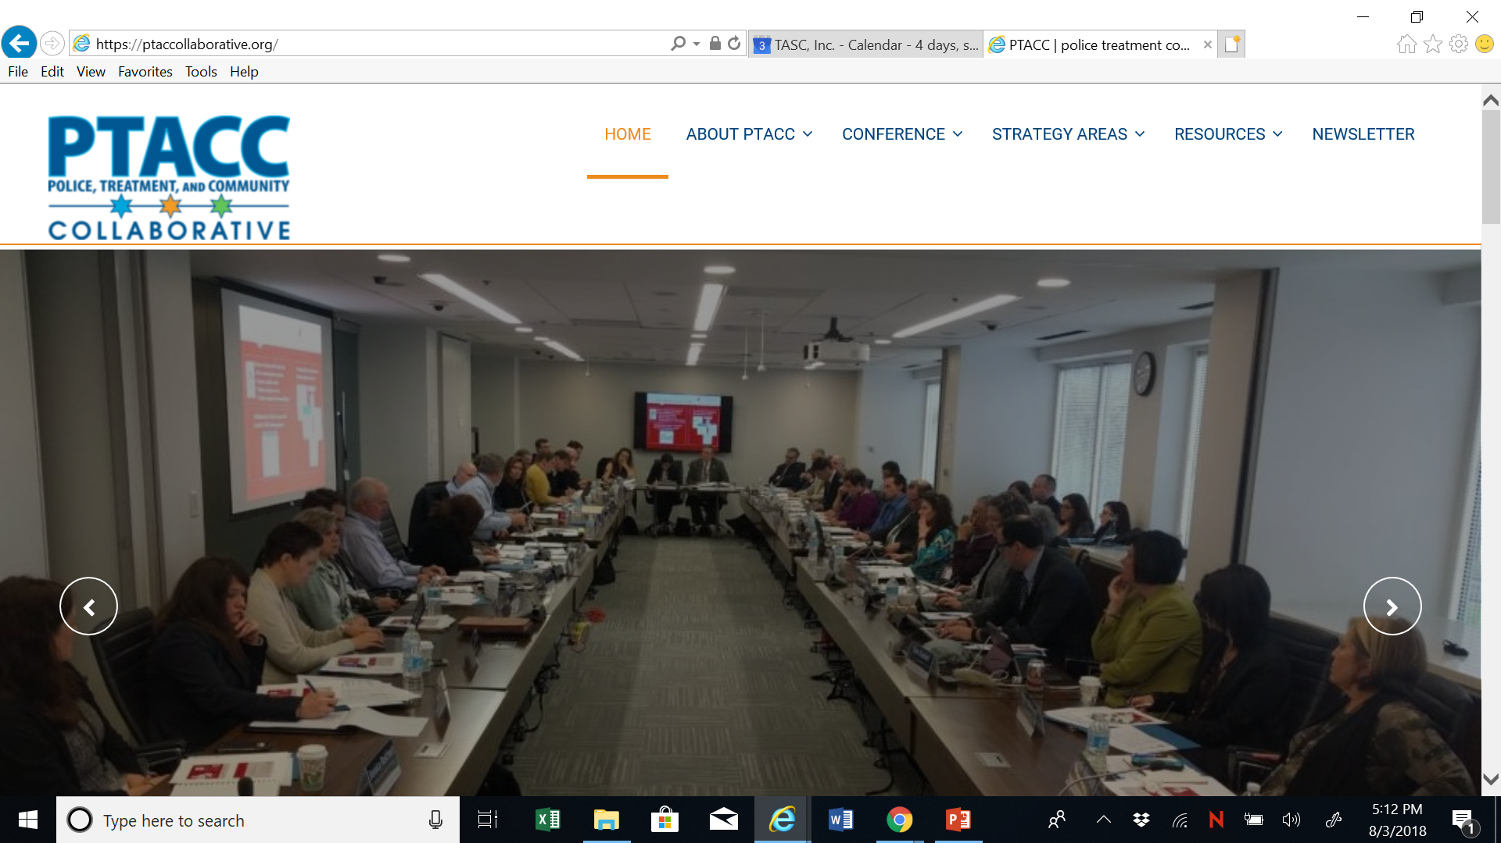
www.ptaccollaborative.org

Slide 26

Jac Charlier
National Director for Justice Initiatives
Center for Health and Justice at TASC
(312) 573-8302
jcharlier@tasc.org
www.ptaccollaborative.org

